Slide 1
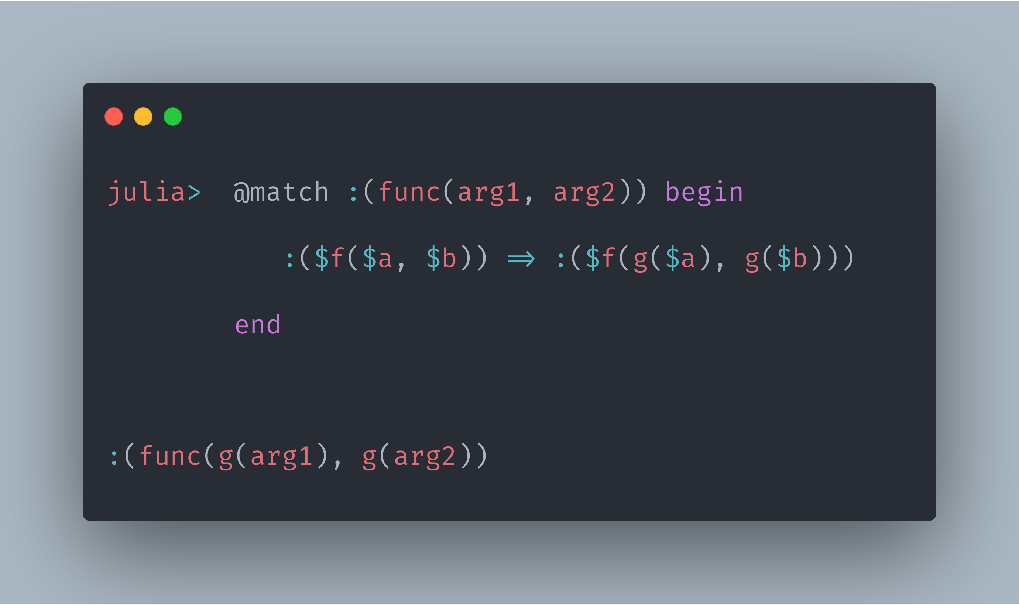
MLStyle.jl
Providing Functional Programming Infrastructures

Slide 2
Who am I?
I’m a student recommended by my idol Oleg Kiselyov to study in University of Tsukuba, Japan. Currently as a kenkyusei, instead of a regular master student, for the admission is in next April.
Major: Metaprogramming(according to Oleg’s recommendation letter), Programming Languages, Functional Programming, etc.
Supervisors: Prof. Yukiyoshi Kameyama and Prof. Oleg Kiselyov.
Thanks to them for the appreciations and helps from them about my application. Thus I can spend more time on working with my favorite fields.

Slide 3
1. What is MLStyle.jl
2. Why I made MLStyle.jl
3. Why use MLStyle.jl
1. Efficiency, and how can?
2. Extensibility, and how can?
3. Additional reasons…
4. Examples

Slide 4
What is MLStyle.jl
ML denotes “Meta Language” here

Slide 5
Functional Programming Infrastructures
Briefly,
Extensible and efficient pattern matching
Data types, syntax extensions, etc.
Matching ASTs syntactically(☺ accidentally but nice to have)

Slide 6
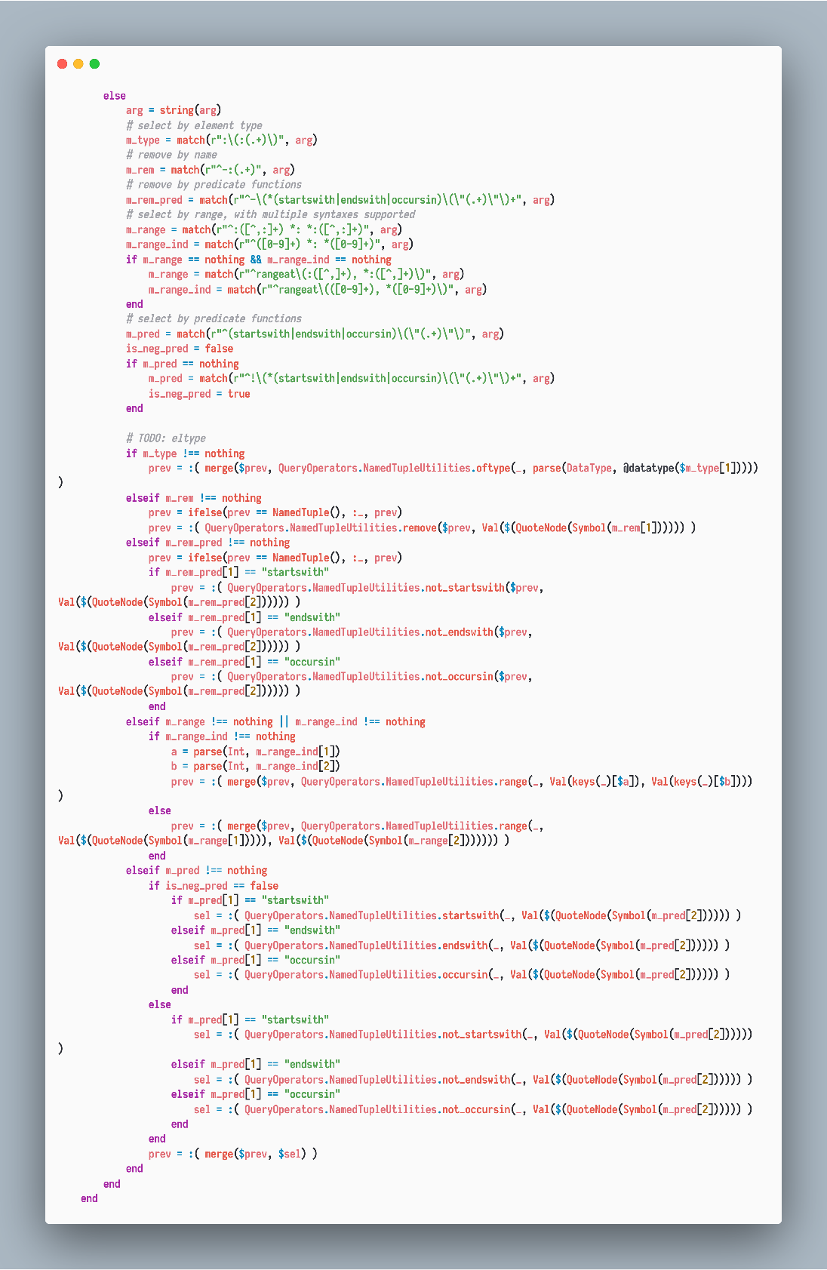
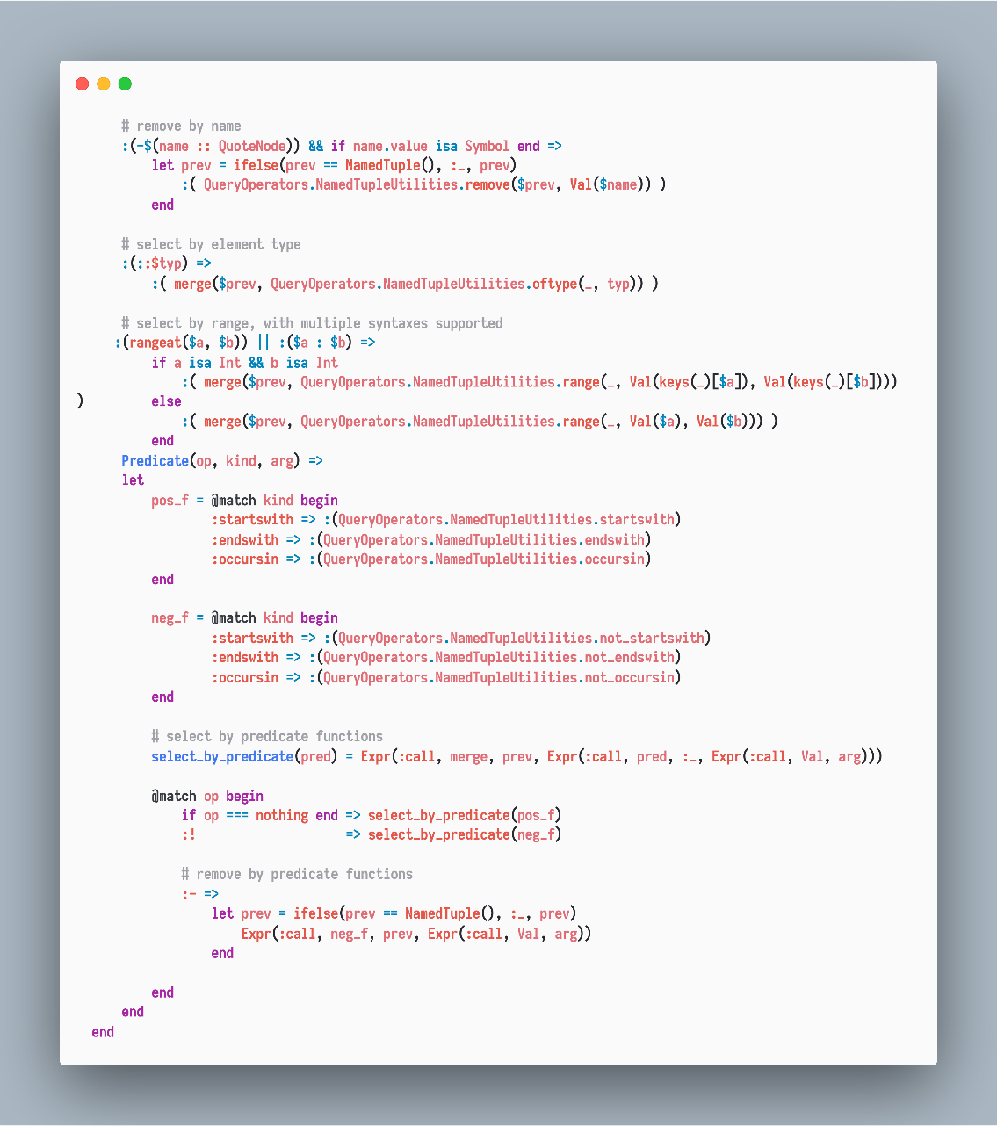
Use MLStyle.jl
For Practice

Slide 7
Playful as well as Practical
Static type checking in 100 lines
Various routes to LISP syntax in 50 lines
Debugger in 200 lines
Parser generators
Extending Julia literals
Transpilers
…(check the repo MLStyle-Playground)
P.S: I believe It’ll work well in GUIs and web dev.

Slide 8
Why I made MLStyle.jl?
Motivations?

Slide 9
Motivations
1. Used to be addicted to pattern matching
2. Noticed a valid syntax to express matching
3. Cannot do this easily in Python
4. The implementation could be efficient and easy
5. Don’t know there’s already Match.jl
6. Possible to define my own patterns, extensible and more
7. Get out of the pervasive limitations around programming

Slide 10
Motivations
Better is better. To gain better
Maintenance: writing maintainable code faster
Readability: writing readable code faster
Efficiency: writing faster code faster
Extensibility: writing extensible code faster

Slide 11
Why use MLStyle.jl
Greatly simplify processing complex conditional logics
Fast
Extensible

Slide 12
Well, MLStyle.jl is fast, extensible and makes logics simpler?
I won’t talk about why pattern matching itself is good, because we’ll dip into this later with examples.
So, how to design and implement the pattern matching that is extensible and efficient?

Slide 13
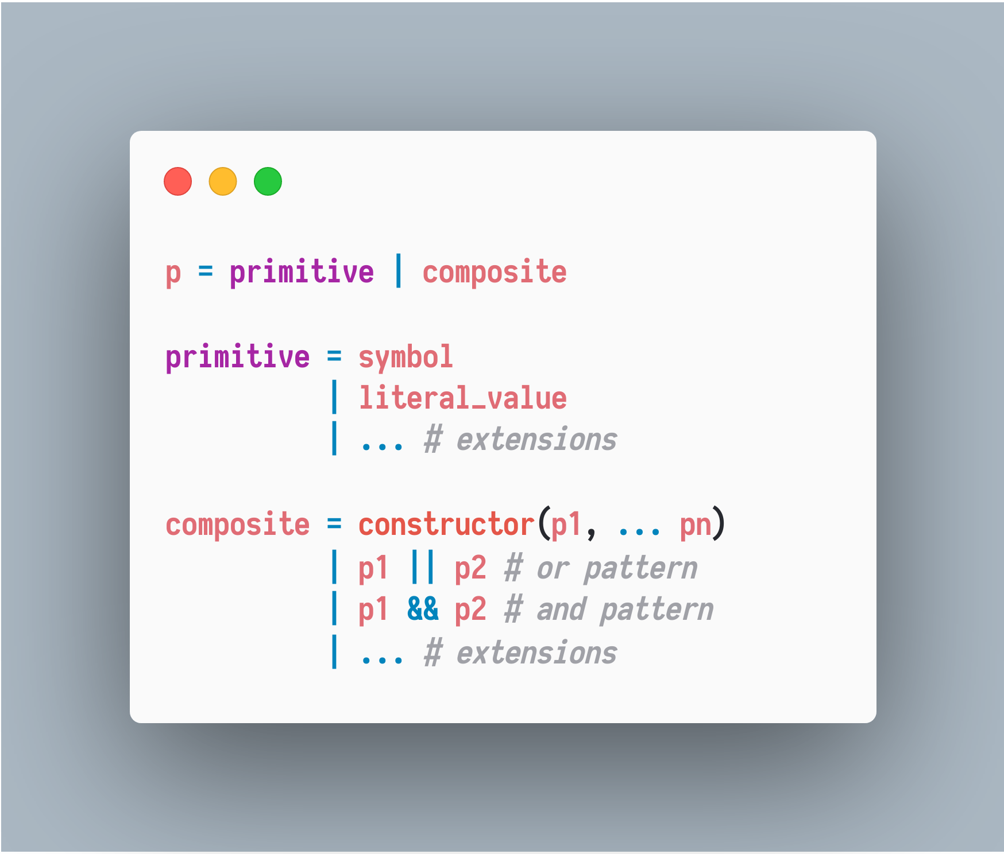

Slide 14
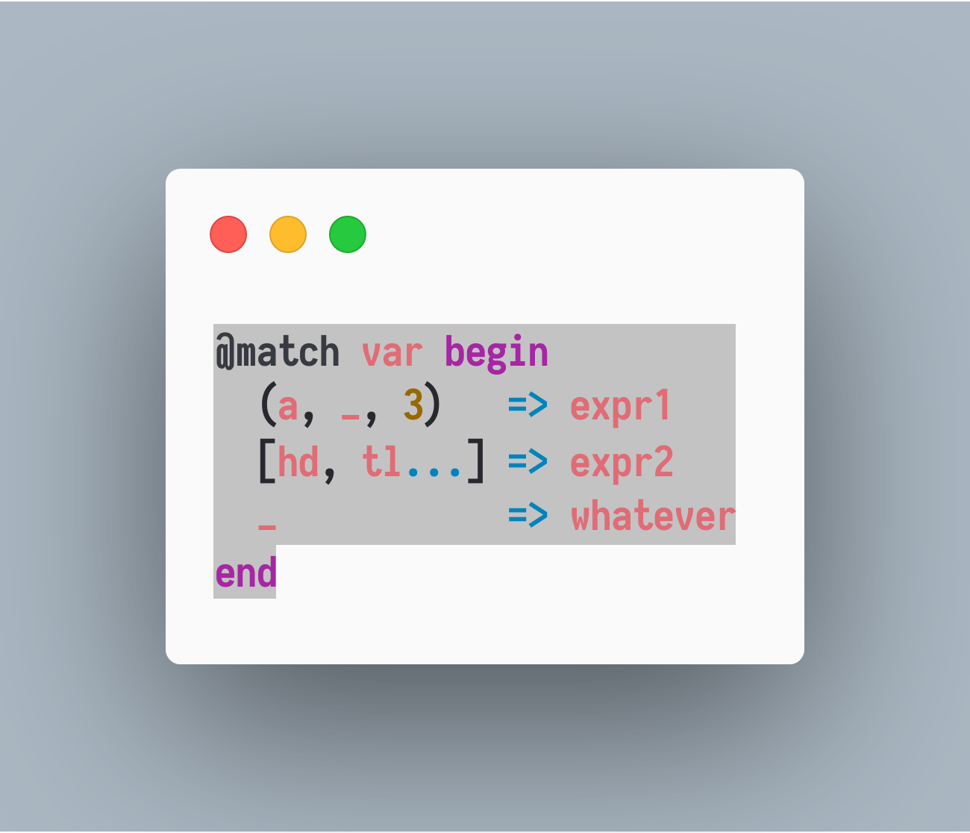
Case study

Slide 15
Decision Tree
Composite
primitive
var : Or
X : Tuple{T1, T2, T3}
Whatever
X : Vector
X : length >= 1
And block
X[2]: pass
view(X,2:end):
captured as tl
X[3]: === 3
X[1] :
captured as a
X[1] :
captured as hd
And block

Slide 16
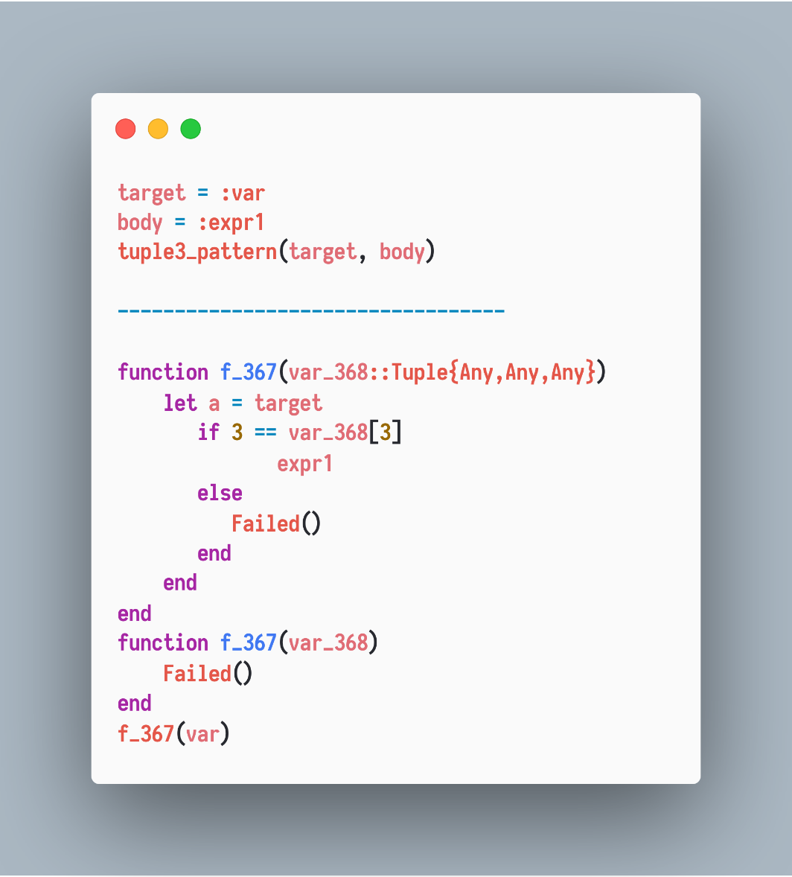
Decision Tree as Function
Composite
primitive
X : Tuple{T1, T2, T3}
X[1] :
captured as a
And block
X[2]: pass
X[3]: === 3

Slide 17
Decision Tree as Function
pattern(target, remainder) = generated_code

Slide 18
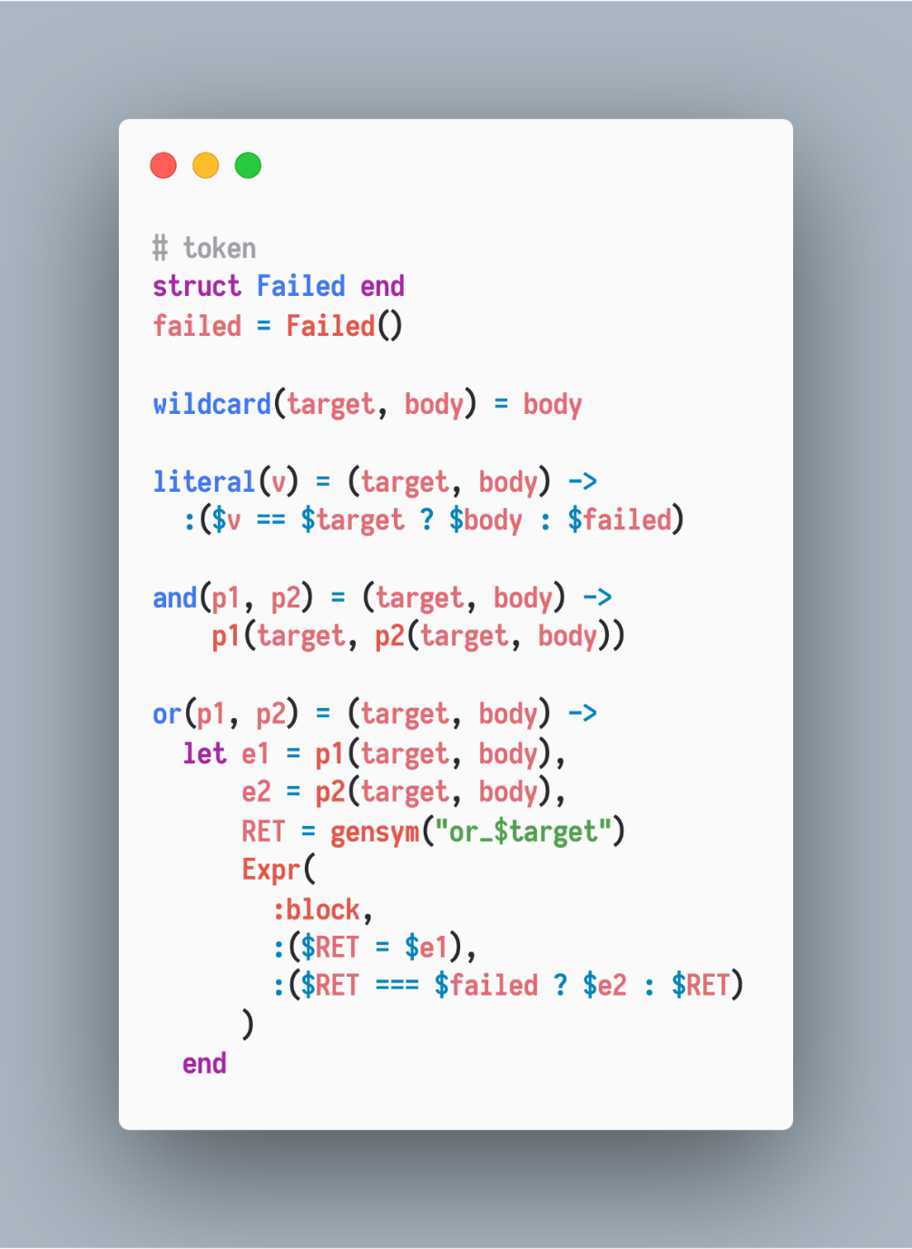
Decision Tree as Function

Slide 19
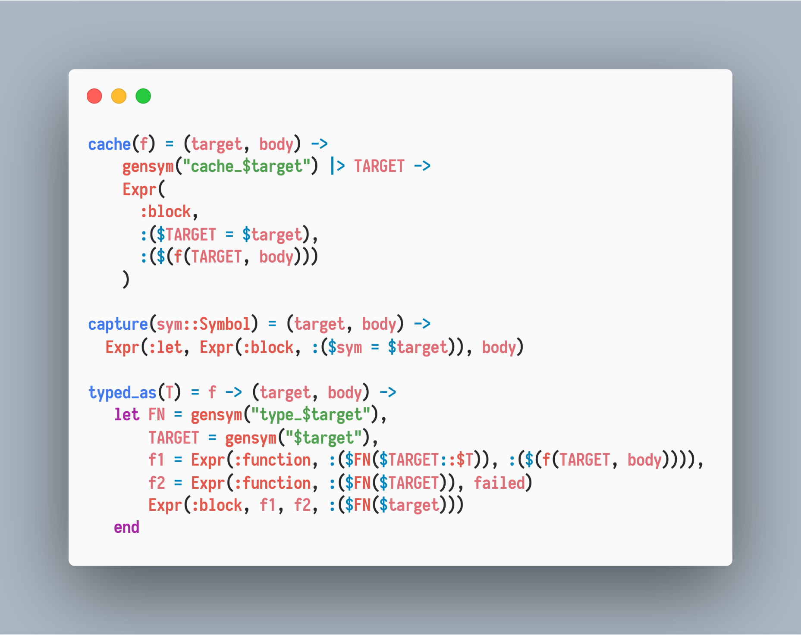
Decision Tree as Function

Slide 20
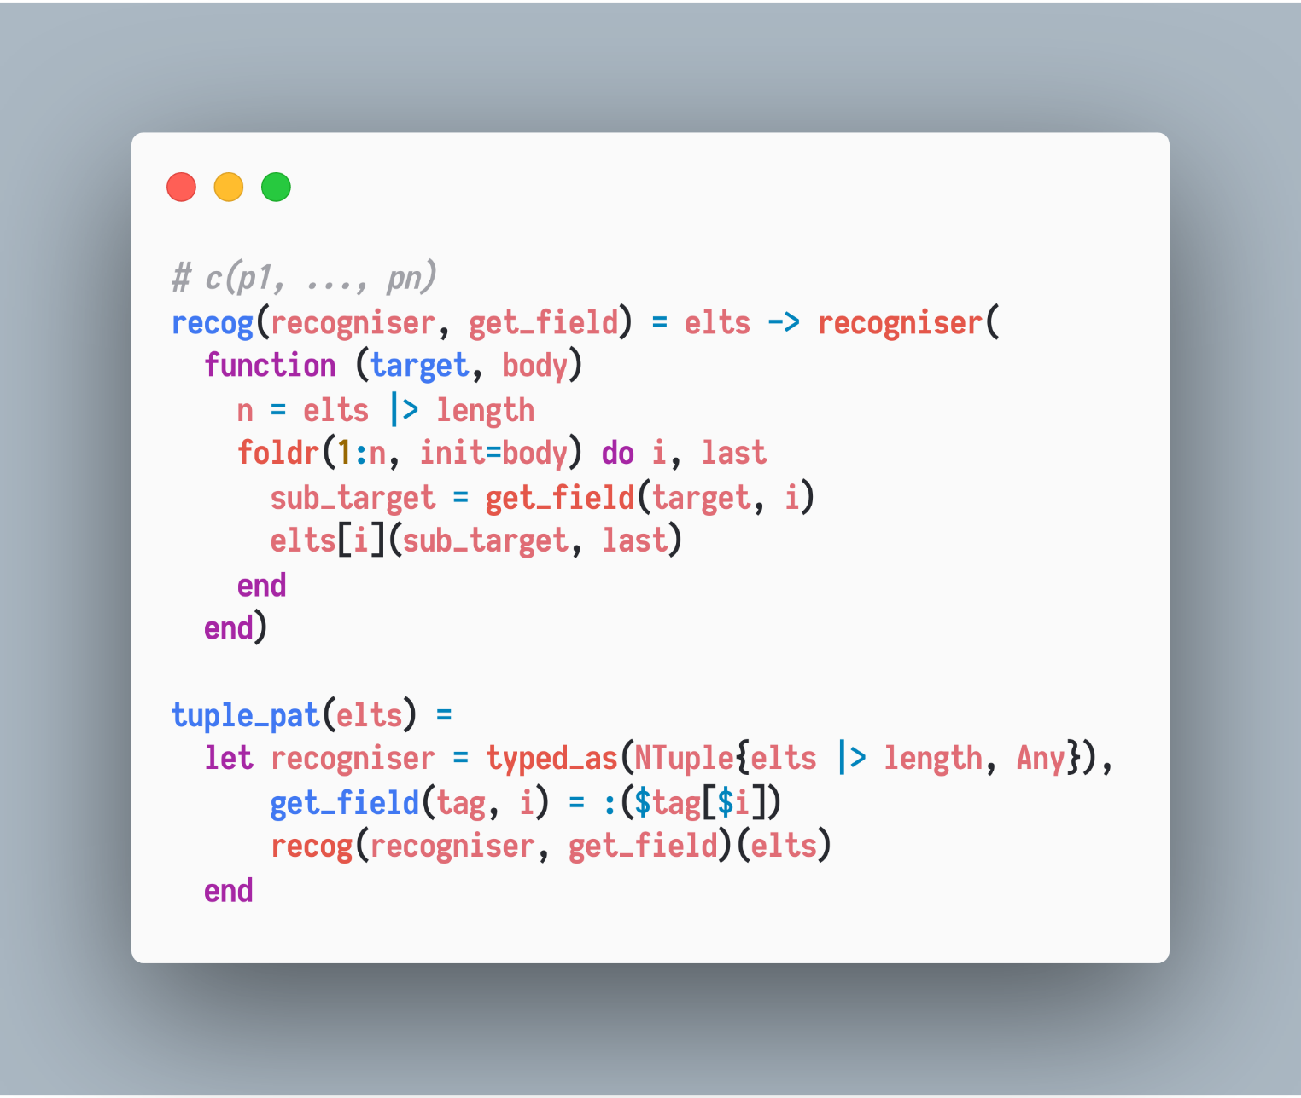
Decision Tree as Function
Constructor patterns/recognisers, e.g., tuple pattern

Slide 21
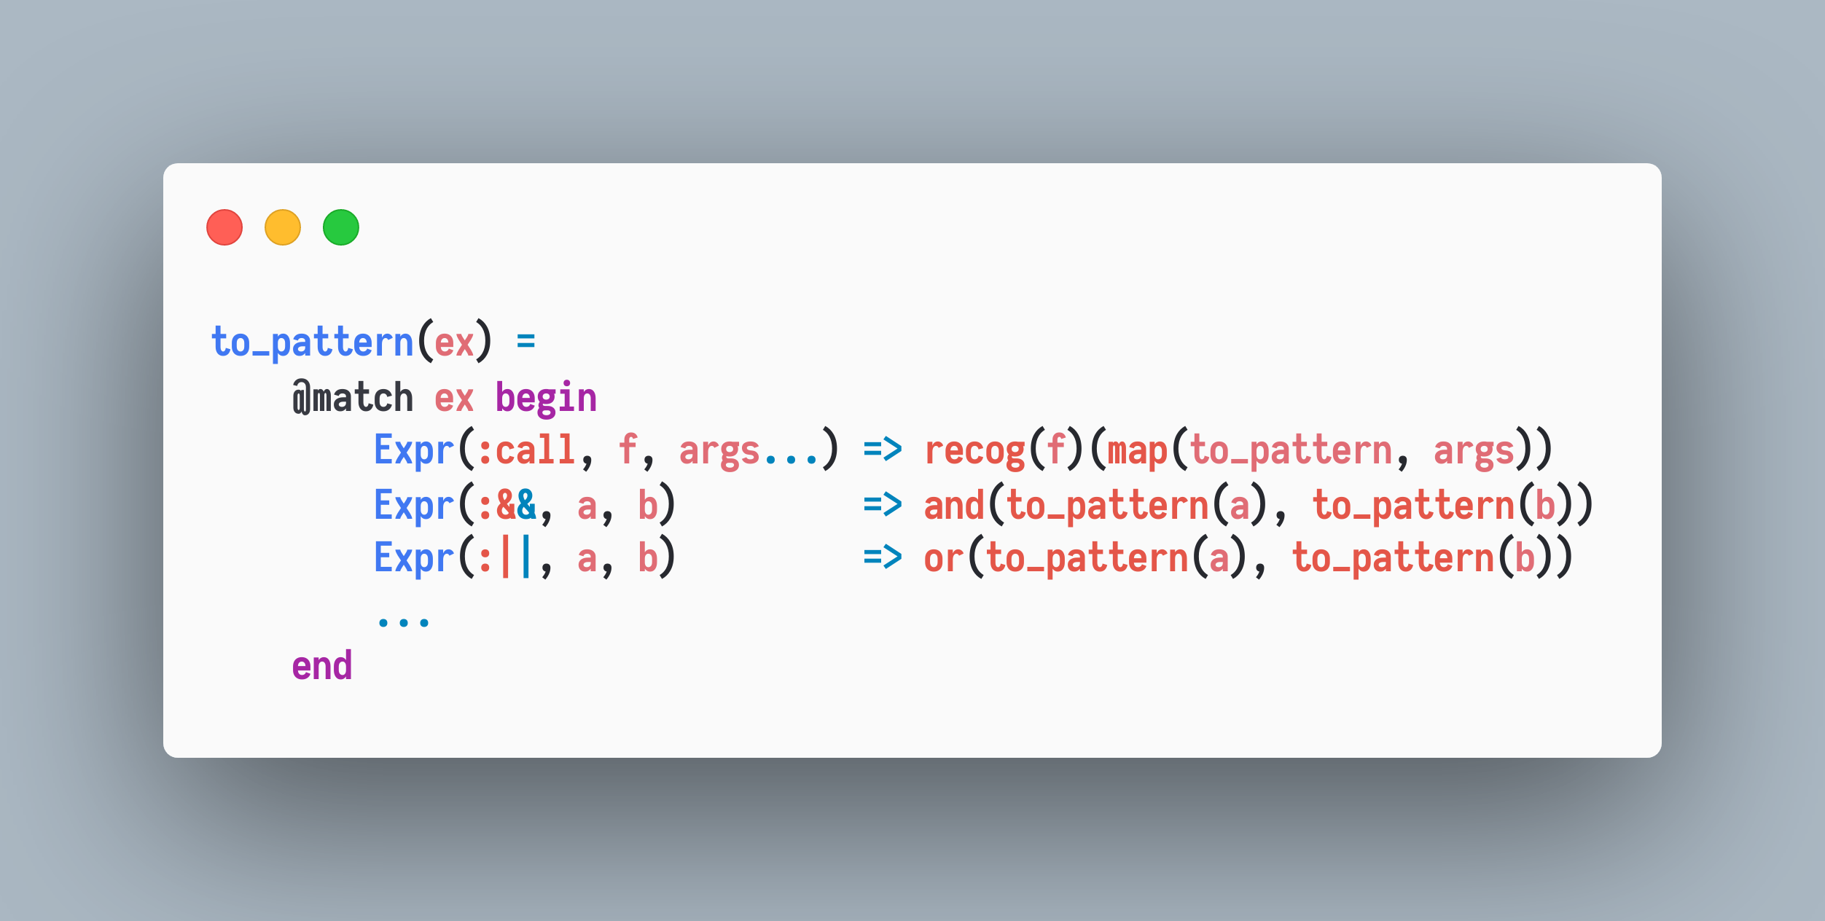
Pattern Matching Syntax
In terms of semantics,

Slide 22
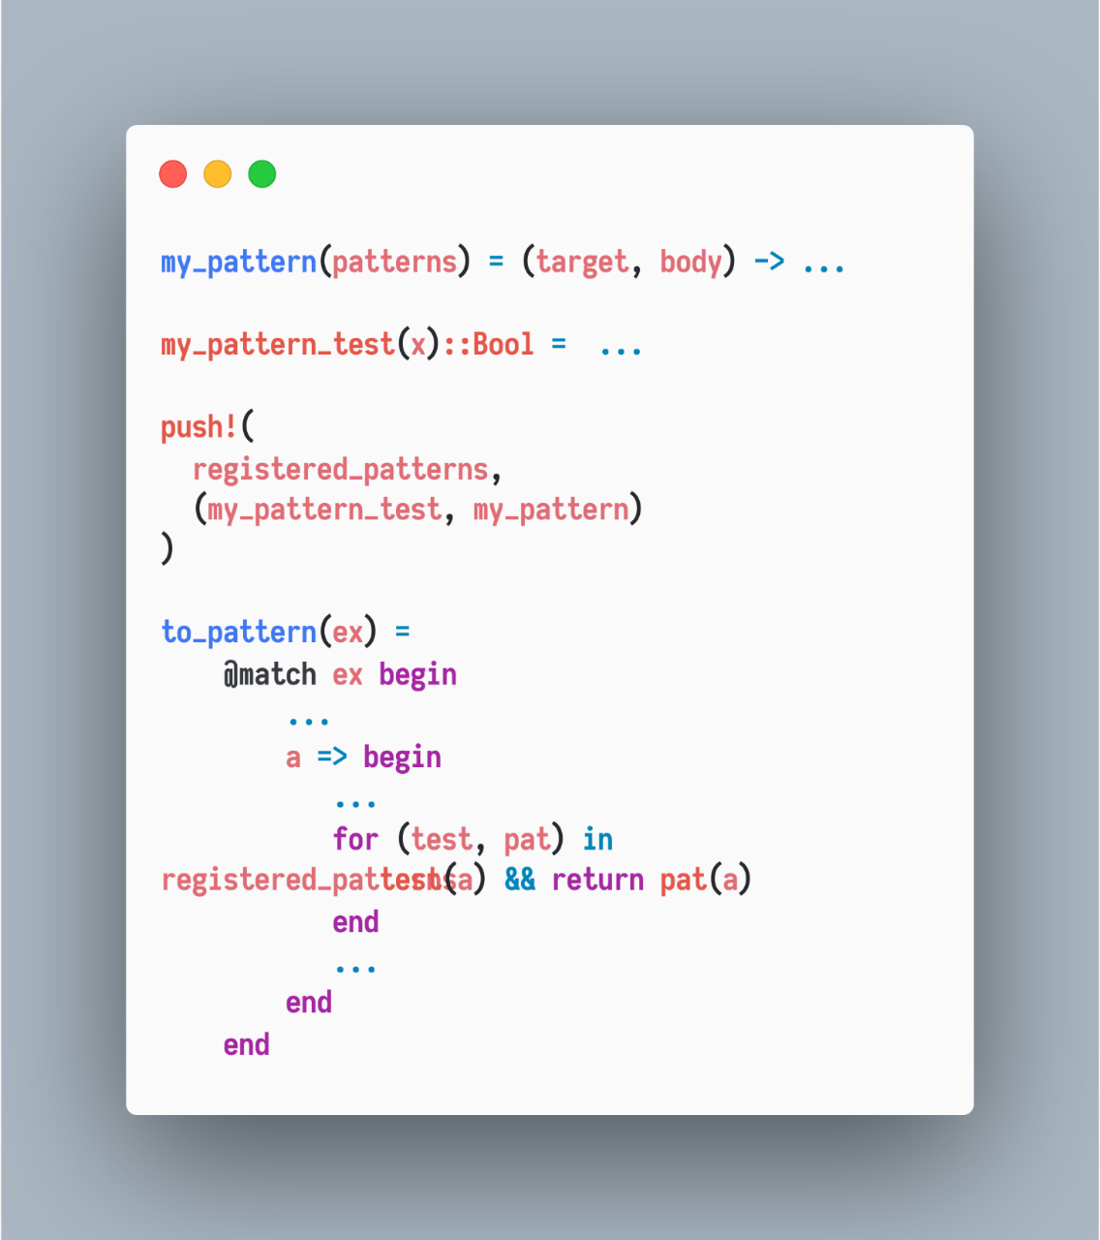
Extensible

Slide 23
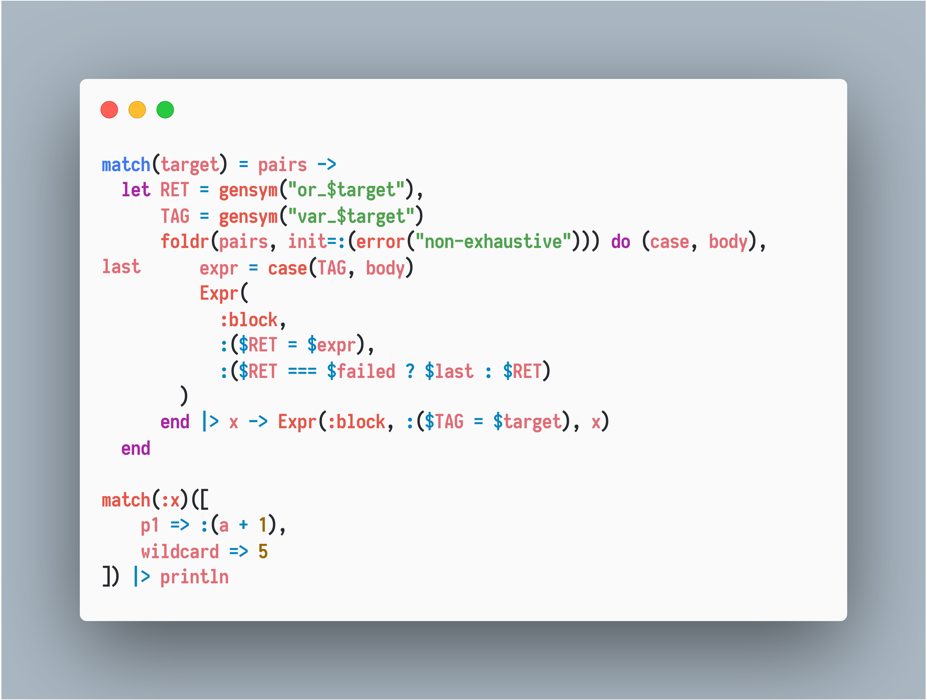

Slide 24
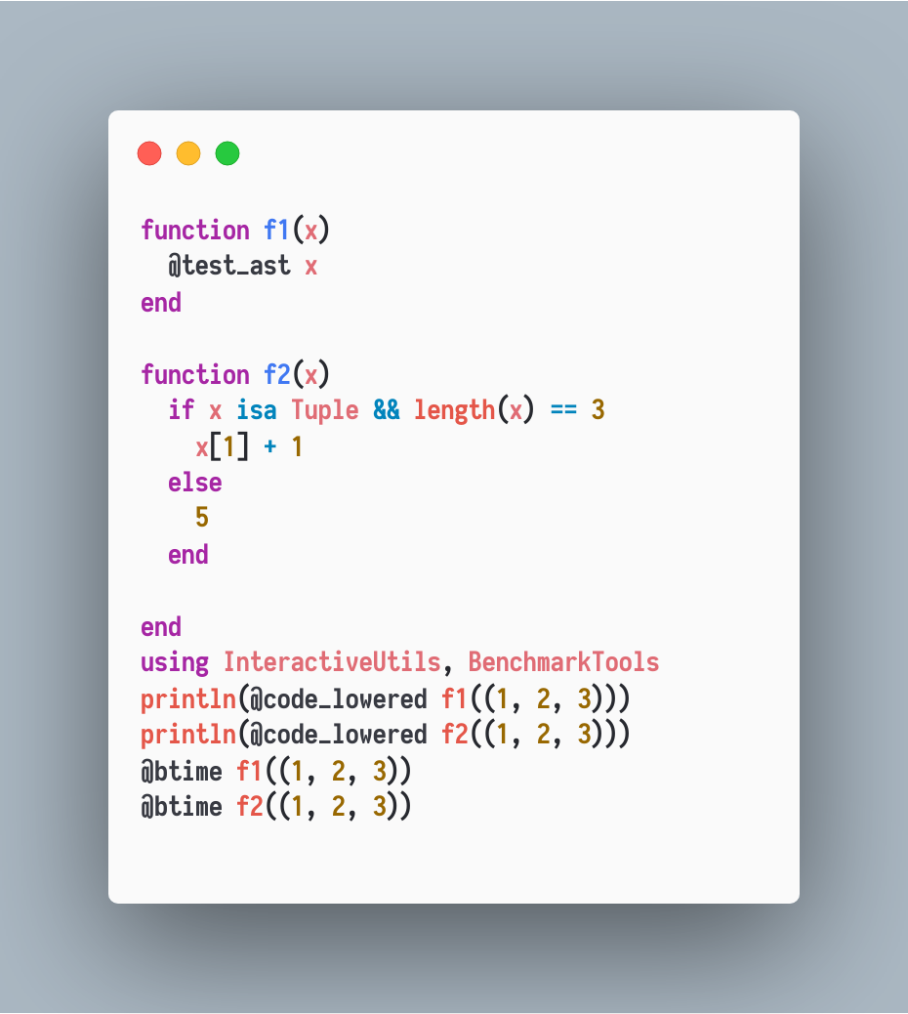
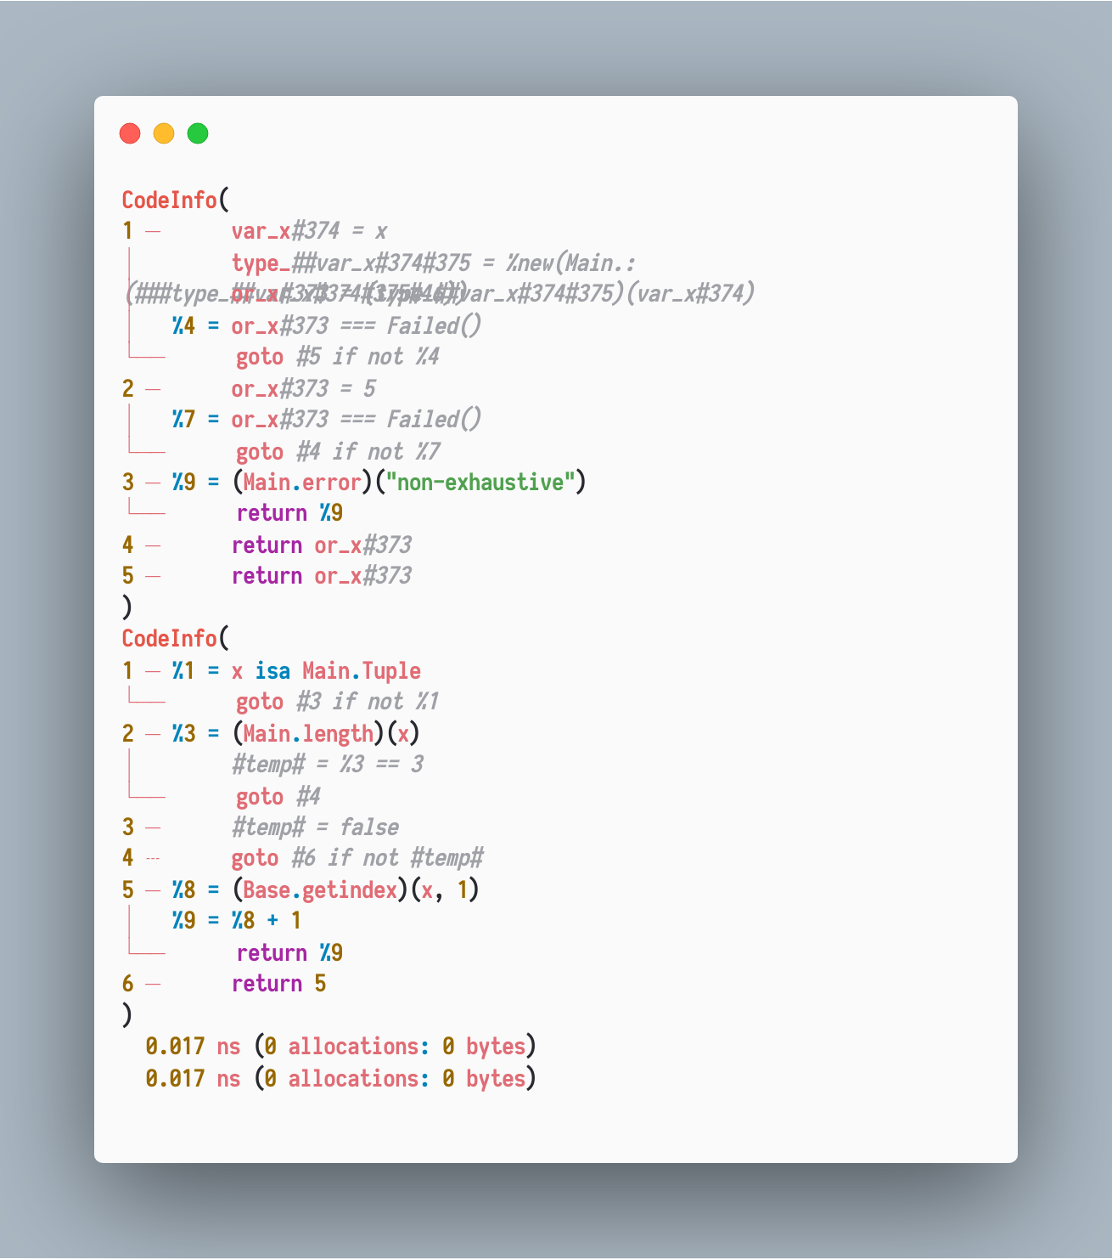
Efficient

Slide 25
The use of the singleton failed does hurt the performance in some cases. Match.jl uses nothing instead of a failed, thus despite of extensibility it’s still weaker(no exhaustive matching) but can be faster in a contrived case:
e.g., when dispatching is not static/cannot get specialized in compiling time.
P.S: Julia optimizes nothing particularly.

Slide 26
Additional Reasons for using MLStyle.jl
1. Frequent and compatible updates for incoming features
to fit the real world demands
2. Fast issue solving
3. I’m doing research in the concerned fields and I have rich skills on
the concerned topics
4. Planning to make MLStyle.jl as a dev-only dependency via
our bootstrap mechanism.
…

Slide 27
Examples
Debugger
Parsing, parsing expression generator
DSL/full featured programming languages
Py2JL.jl/Transpilers
Extending literal syntaxes
Query eDSL
Syntax extension
Static type checking for Julia (special thanks to Jonathan Bieler!)

Slide 28
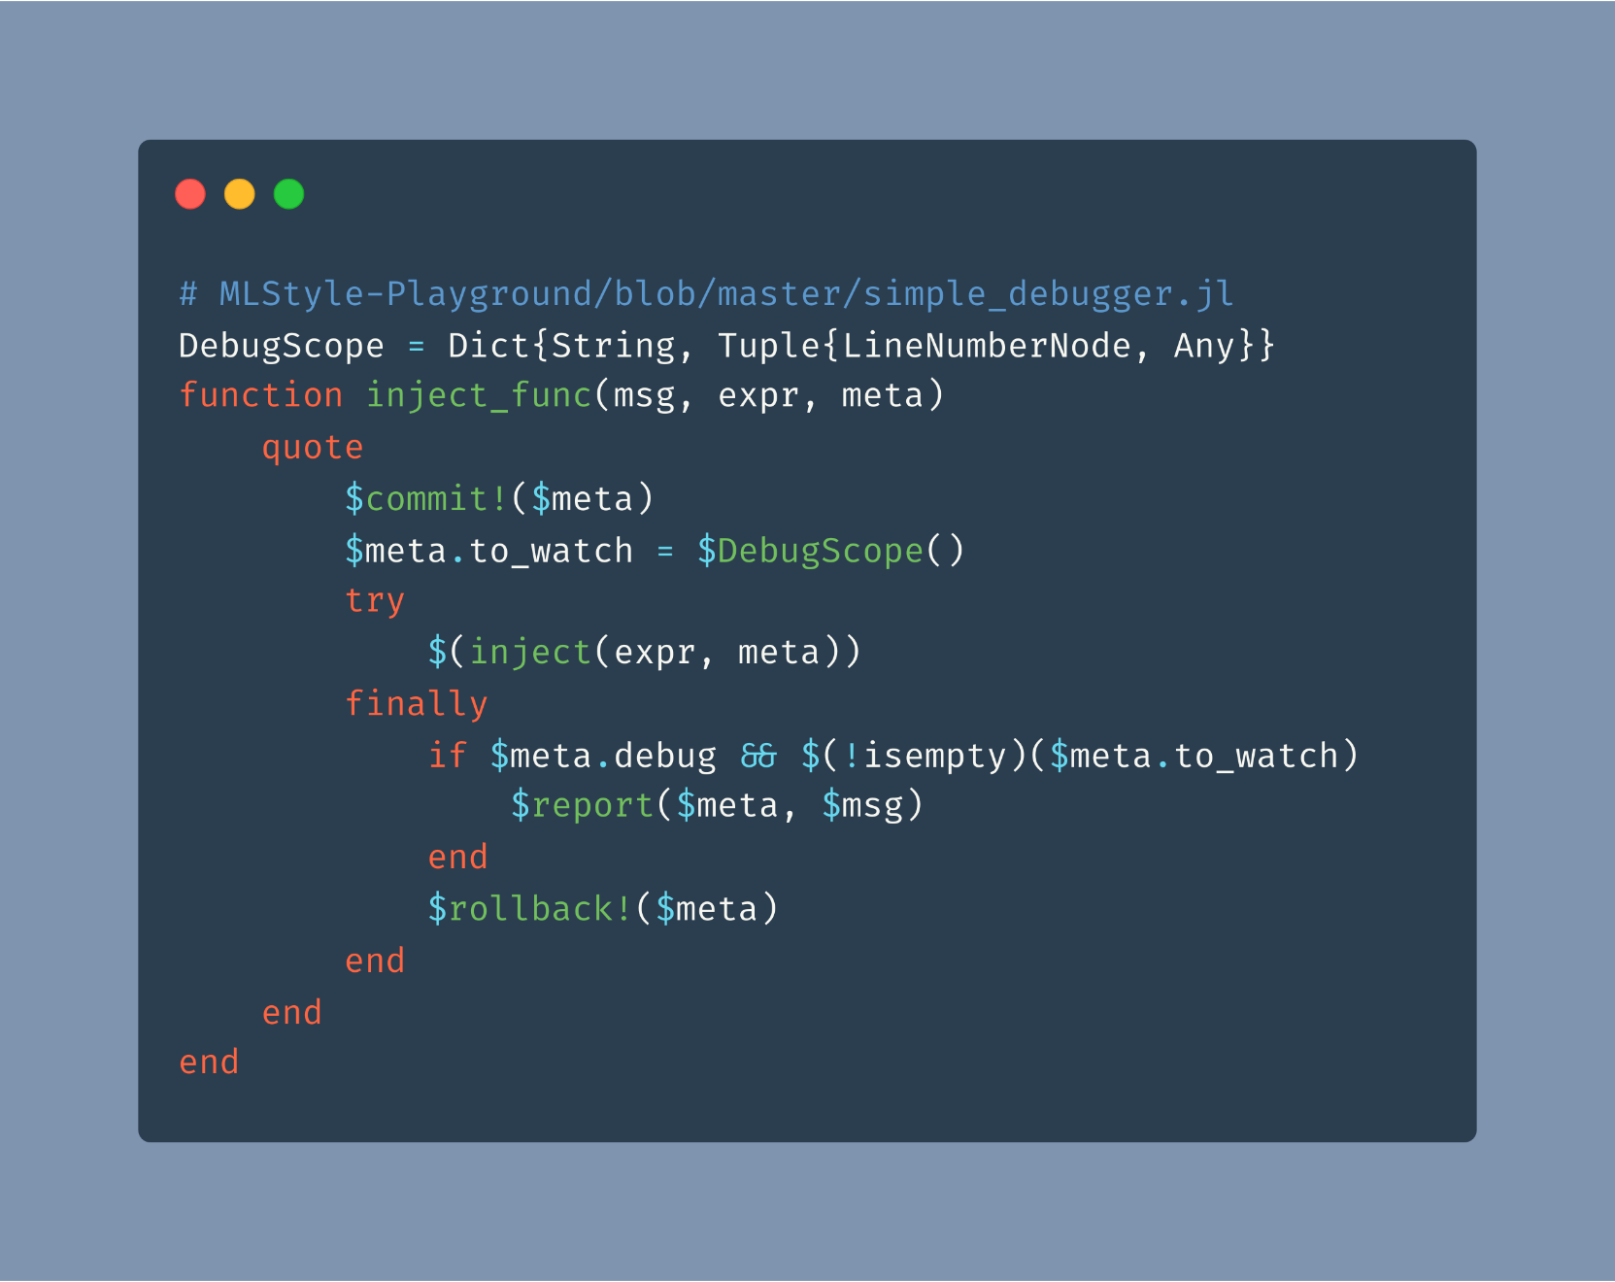
Examples – Debugger

Slide 29
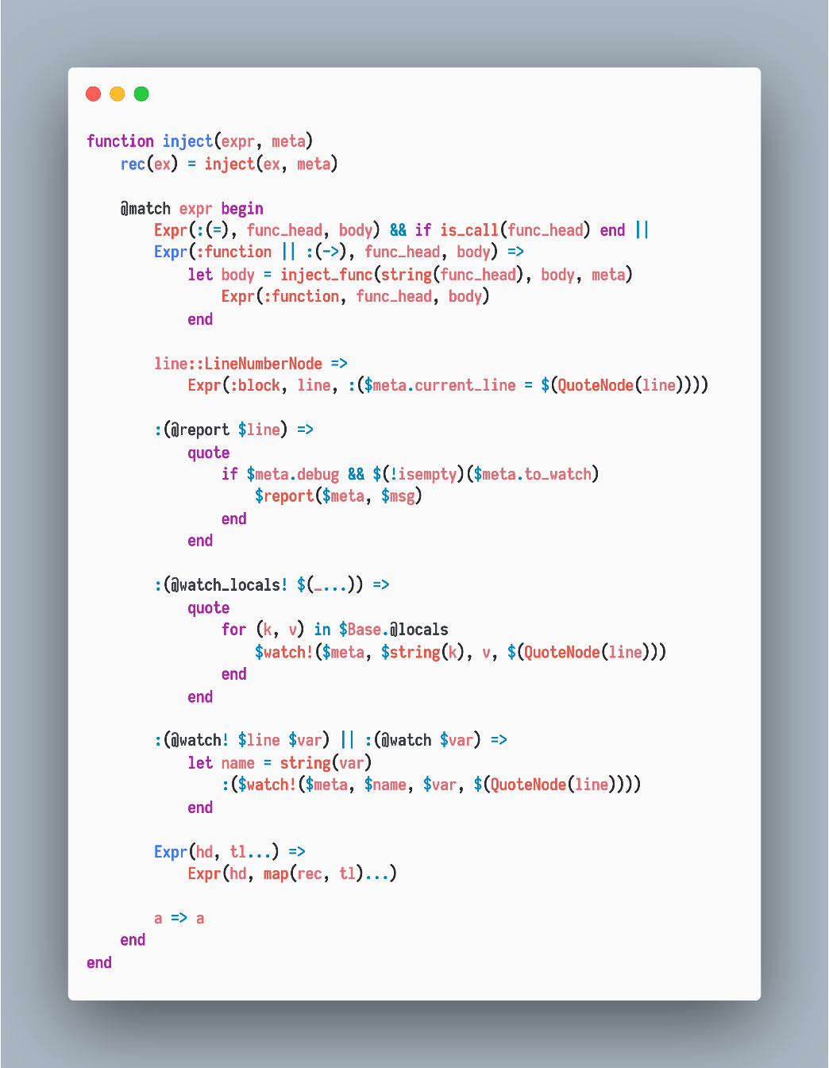
Examples – Debugger

Slide 30
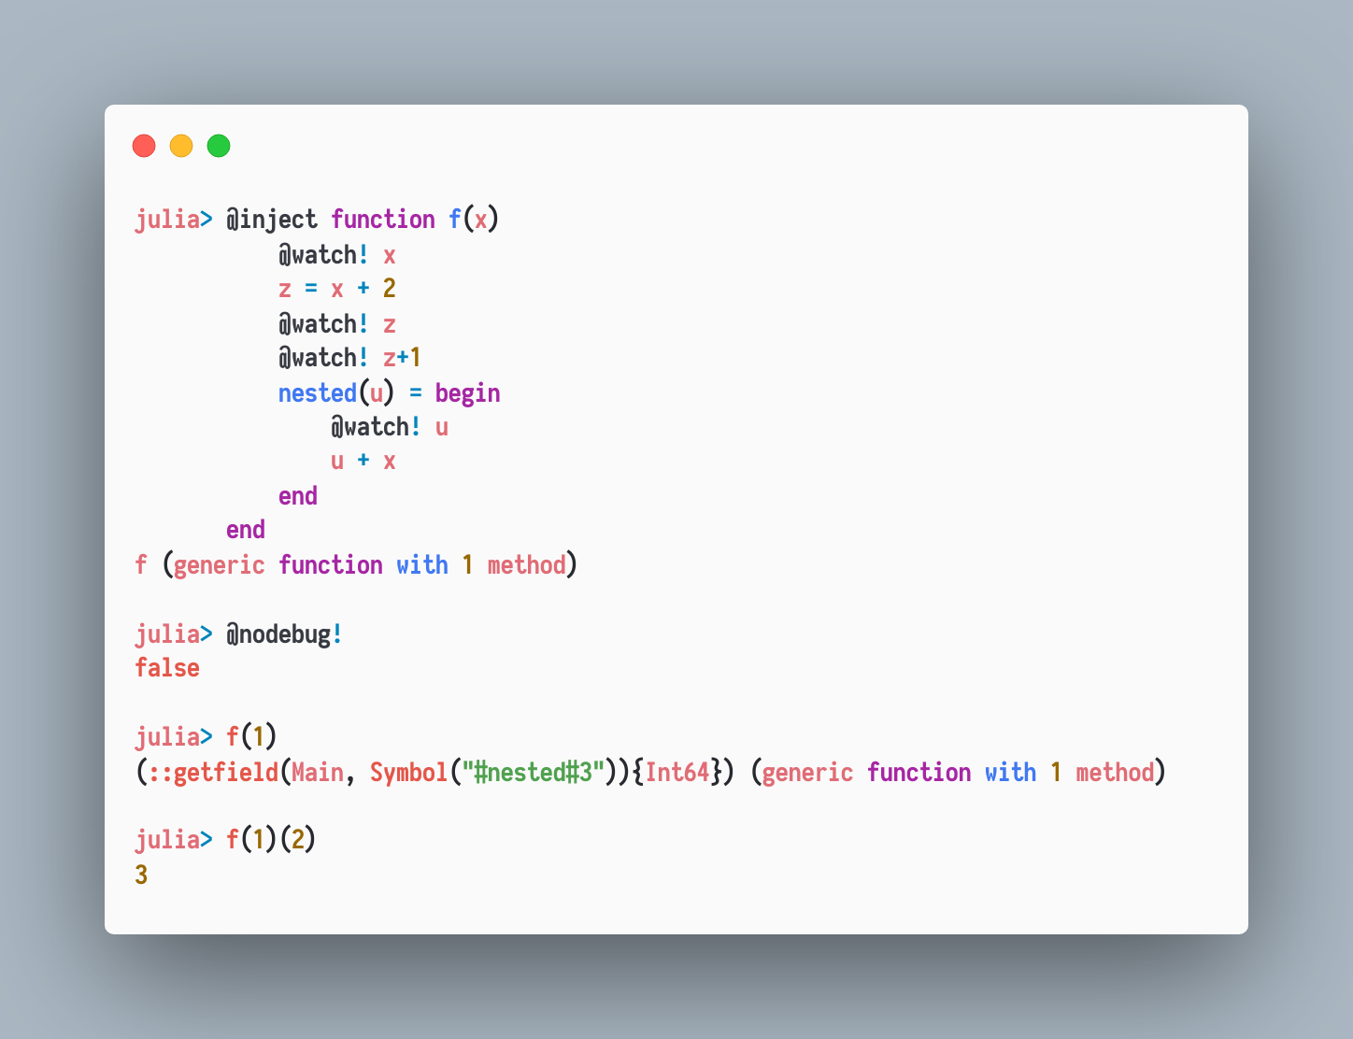
Examples – Debugger

Slide 31
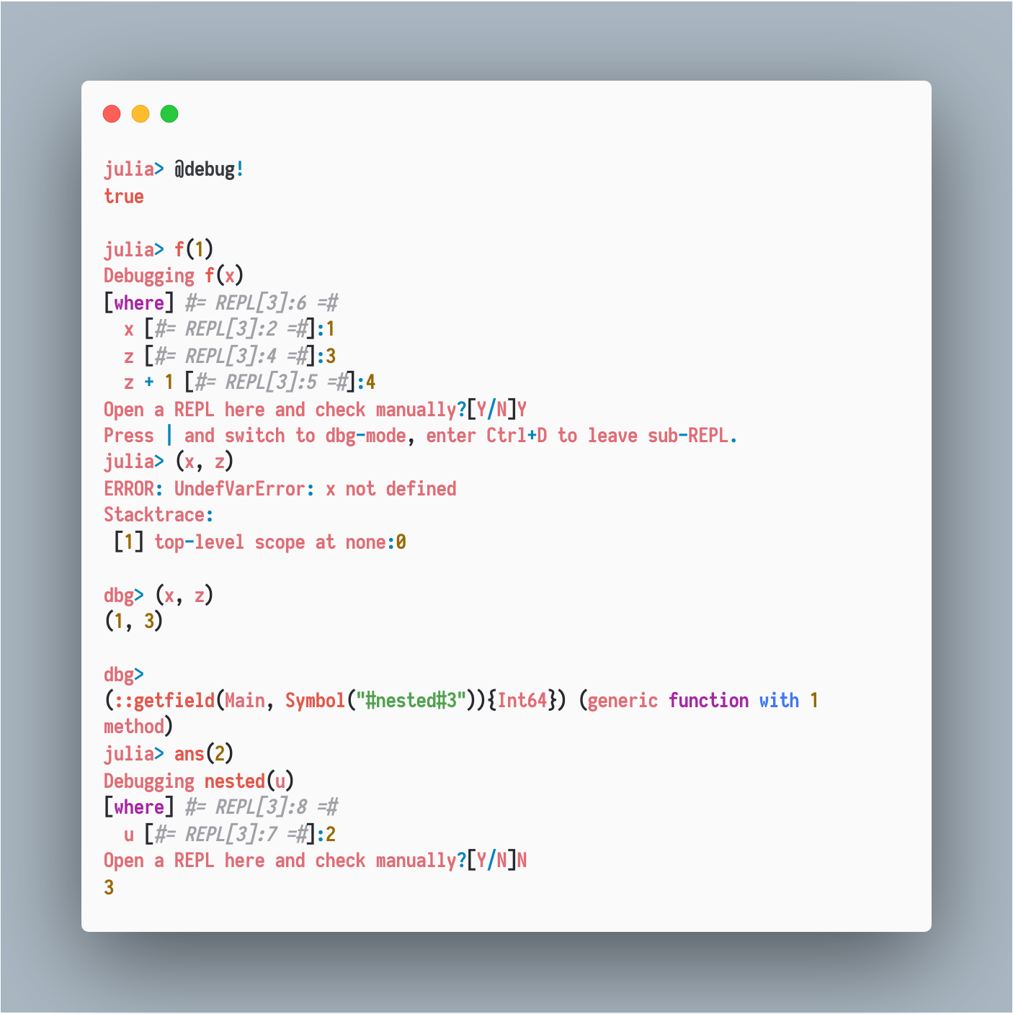
Examples – Debugger

Slide 32
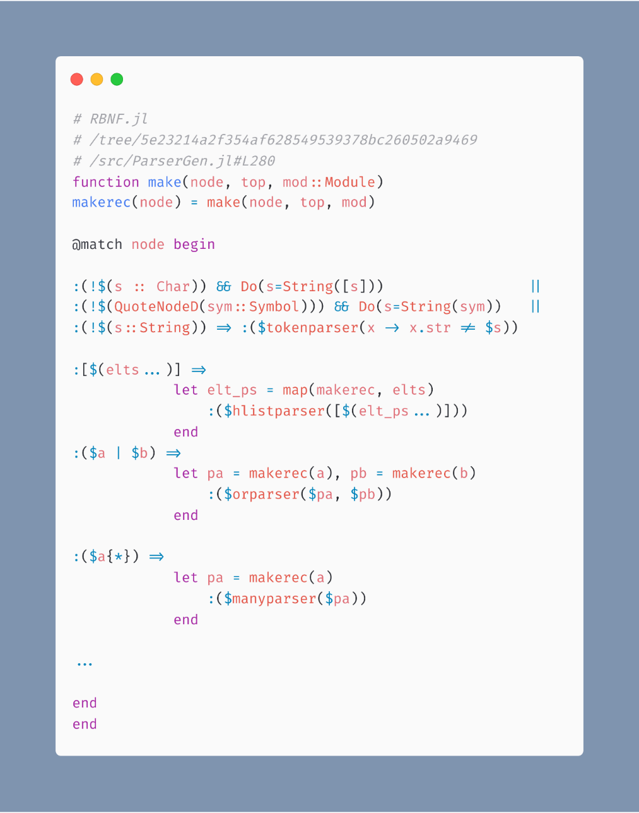
Examples - Parsing
RBNF.jl
Julia Syntaxes -> Parser Combinators

Slide 33
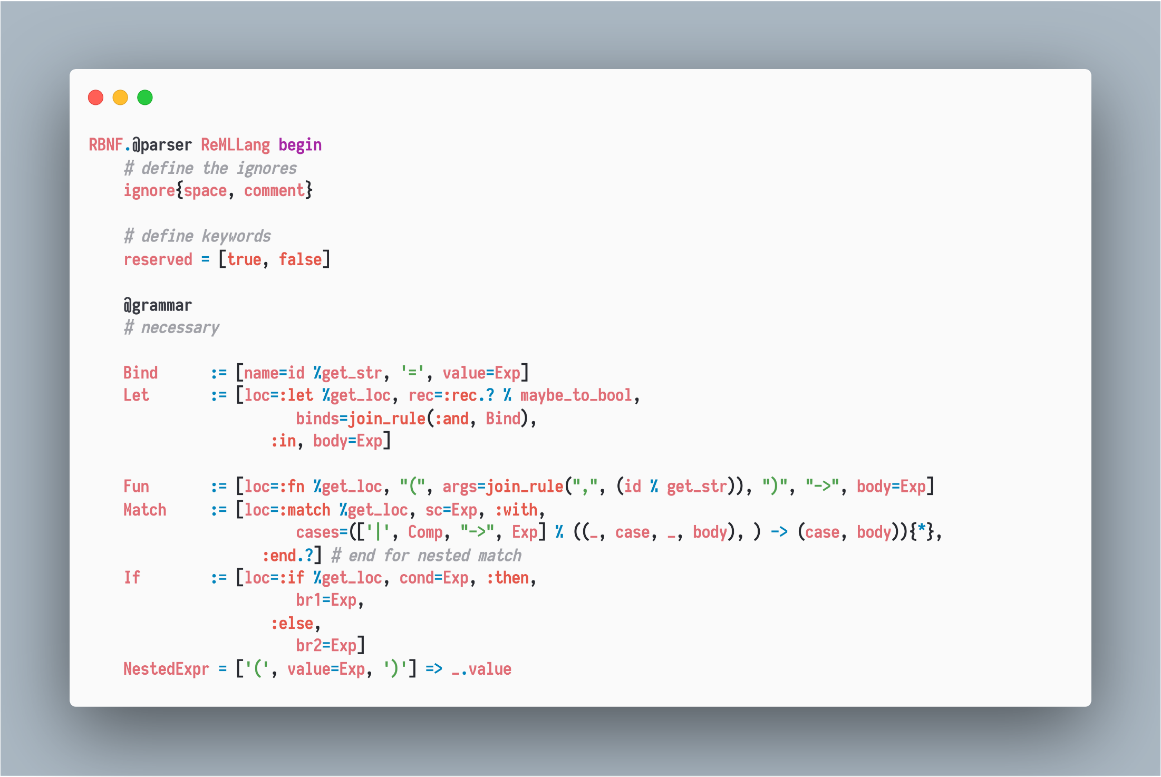
Examples - Parsing
Syntax-driven
intuitive

Slide 34
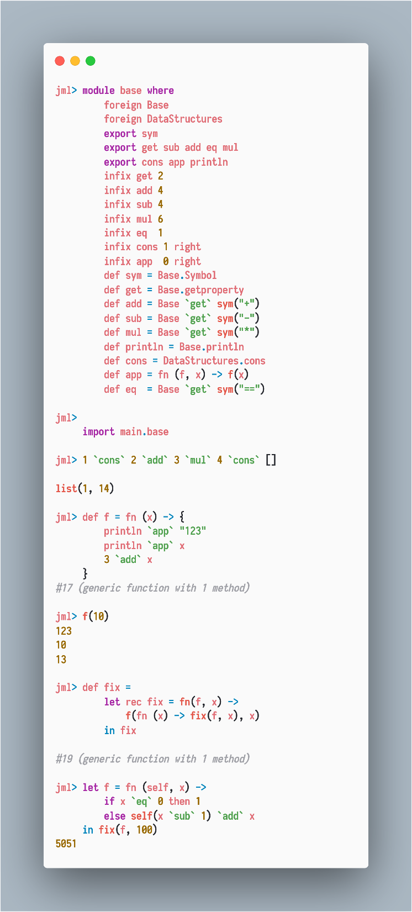
Examples - DSL
Parser from Example-Parsing section.
1. Custom precedences and associativities
2. Let bindings, let-rec bindings
…

Slide 35
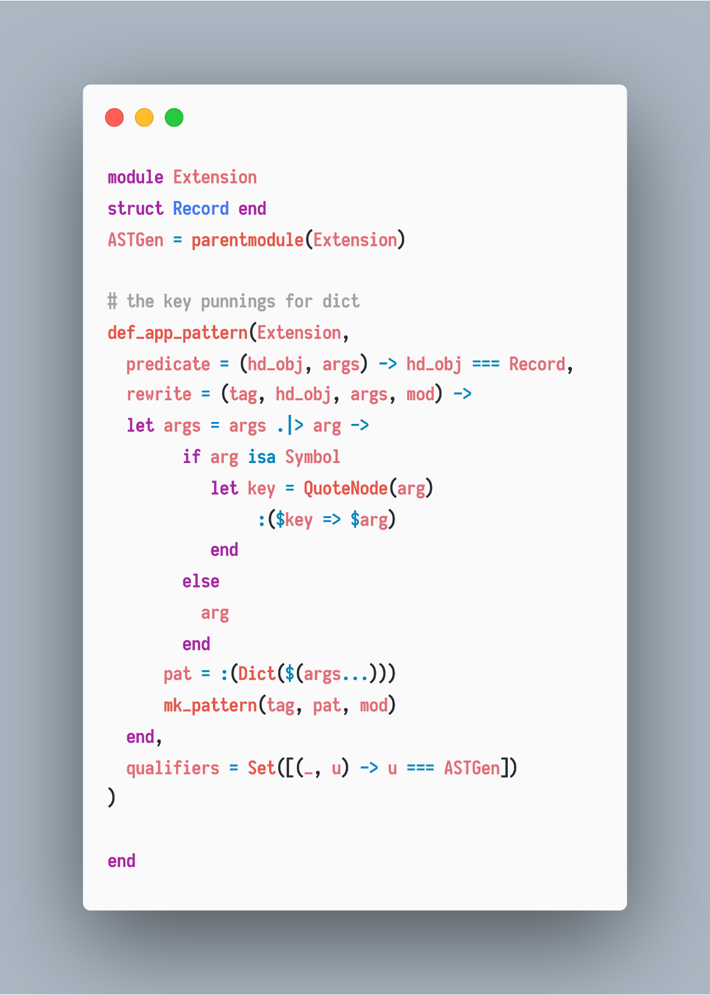
Examples – Py2Jl.jl
A custom pattern Record providing a more handy way to match Dict{Symbol, T}

Slide 36
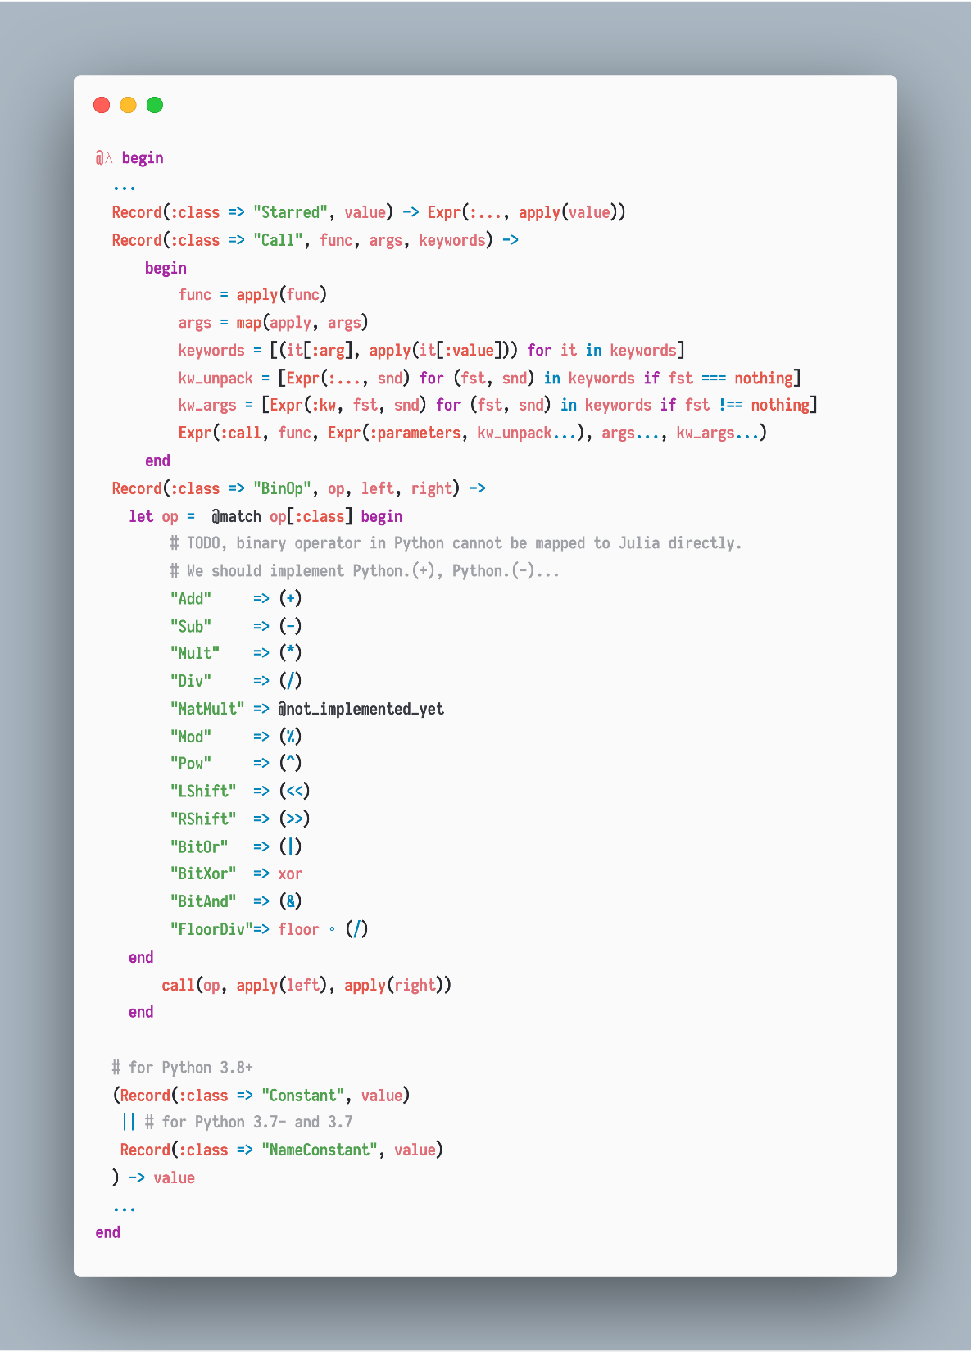
Examples – Py2Jl.jl

Slide 37
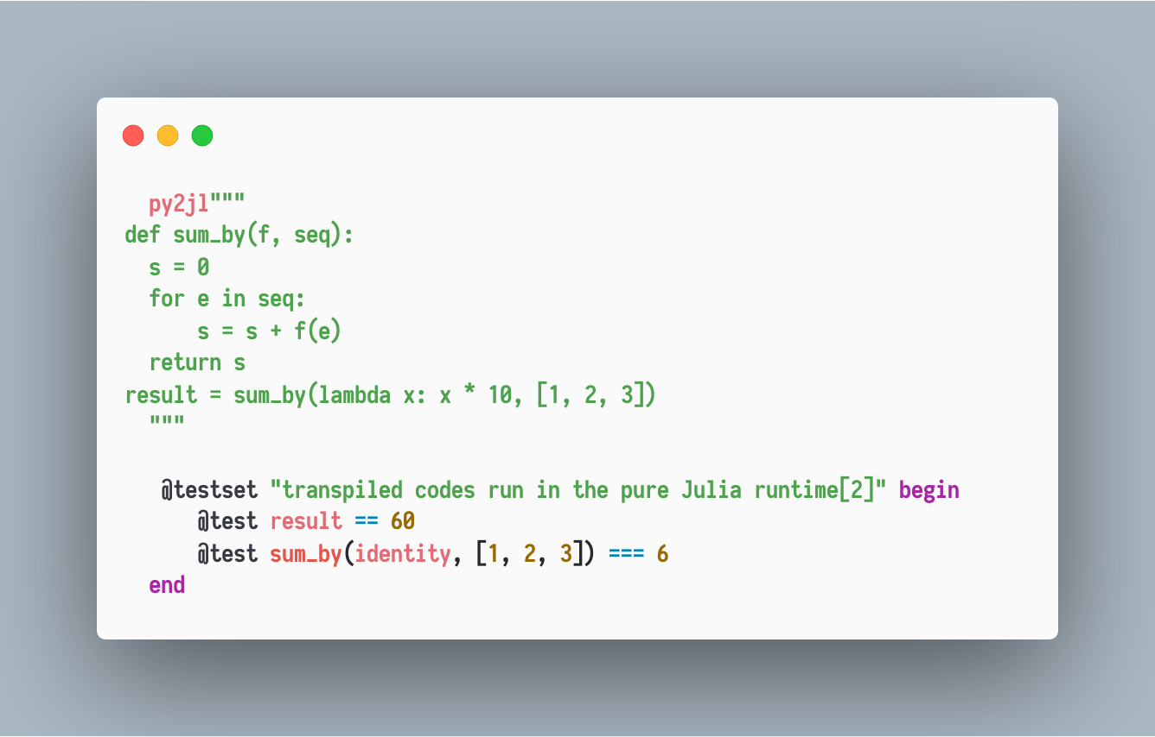
Examples – Py2Jl.jl

Slide 38
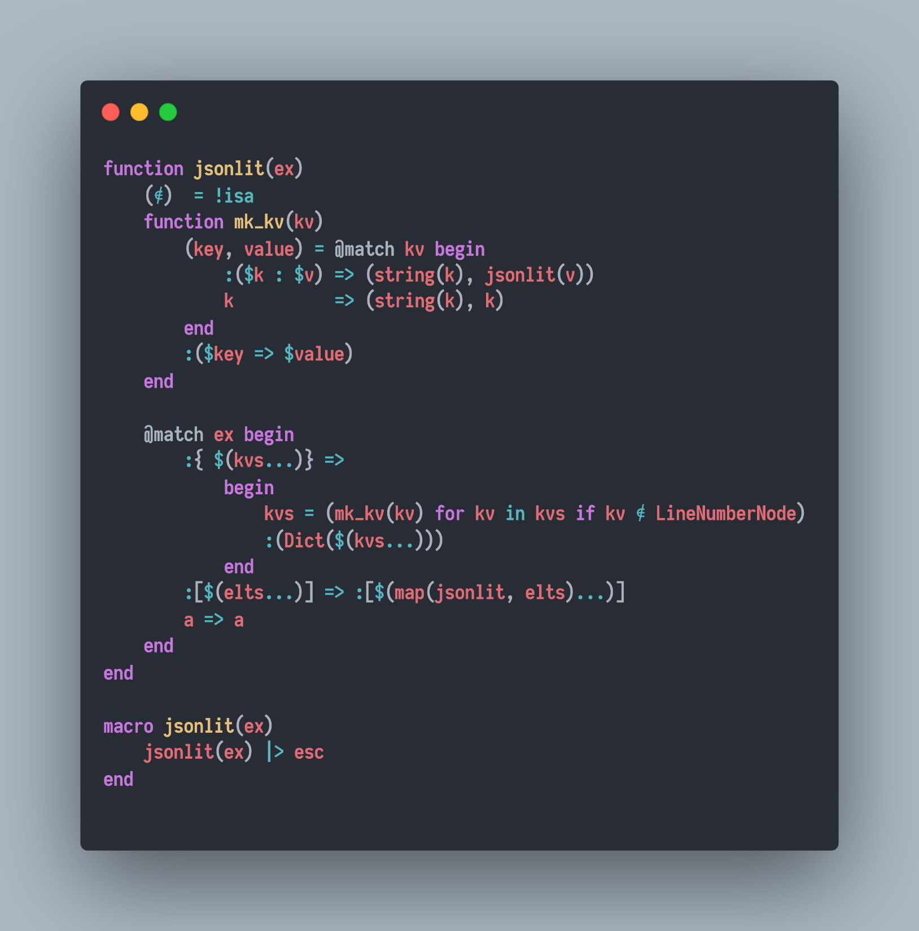
Examples - Extending literal syntaxes

Slide 39
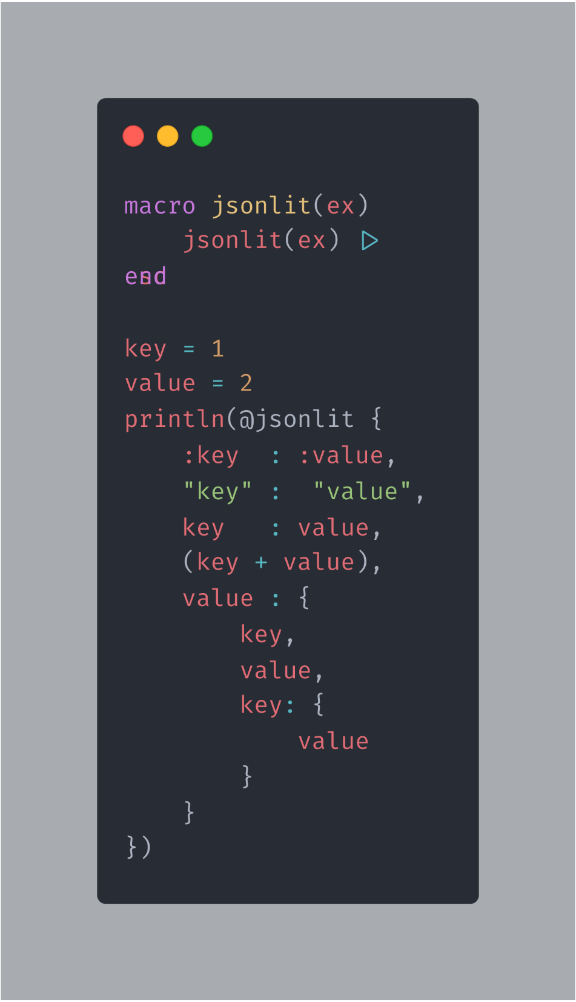
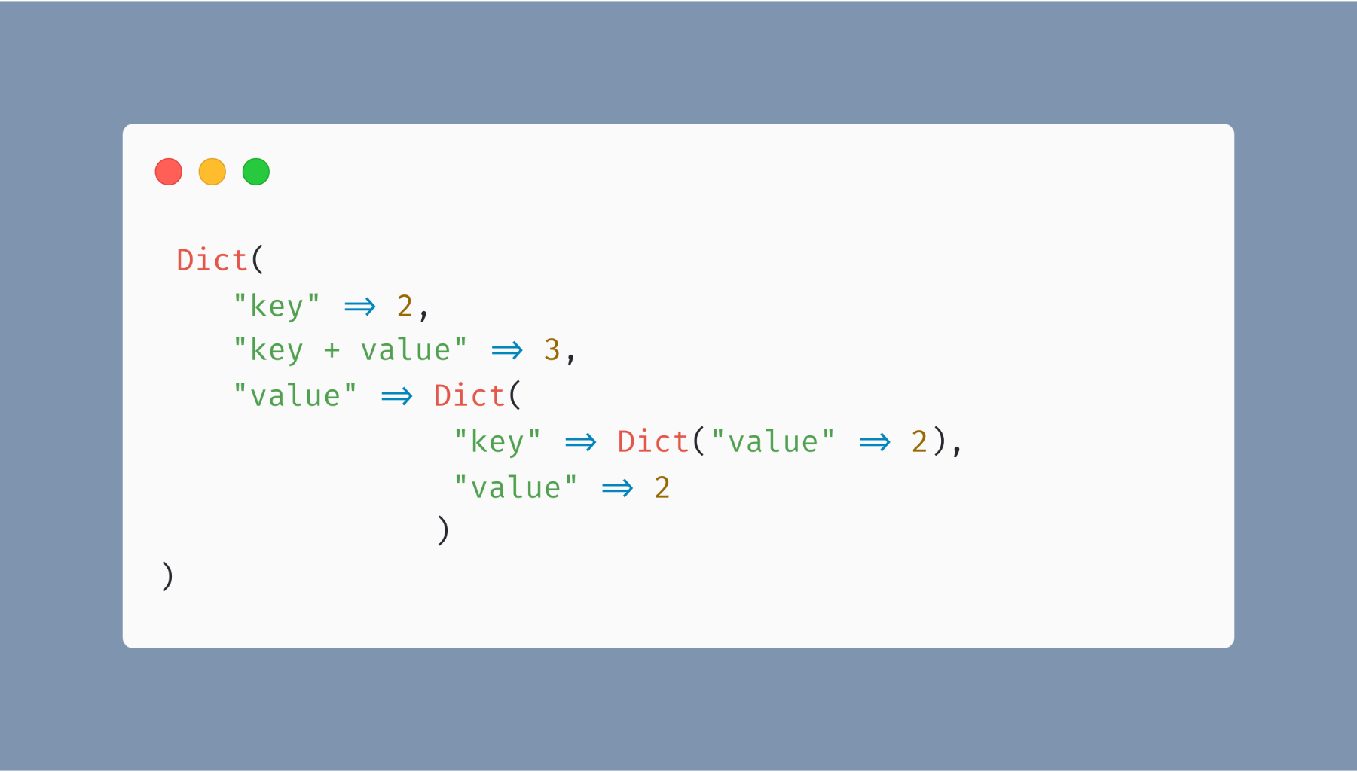
Examples - Extending literal syntaxes

Slide 40
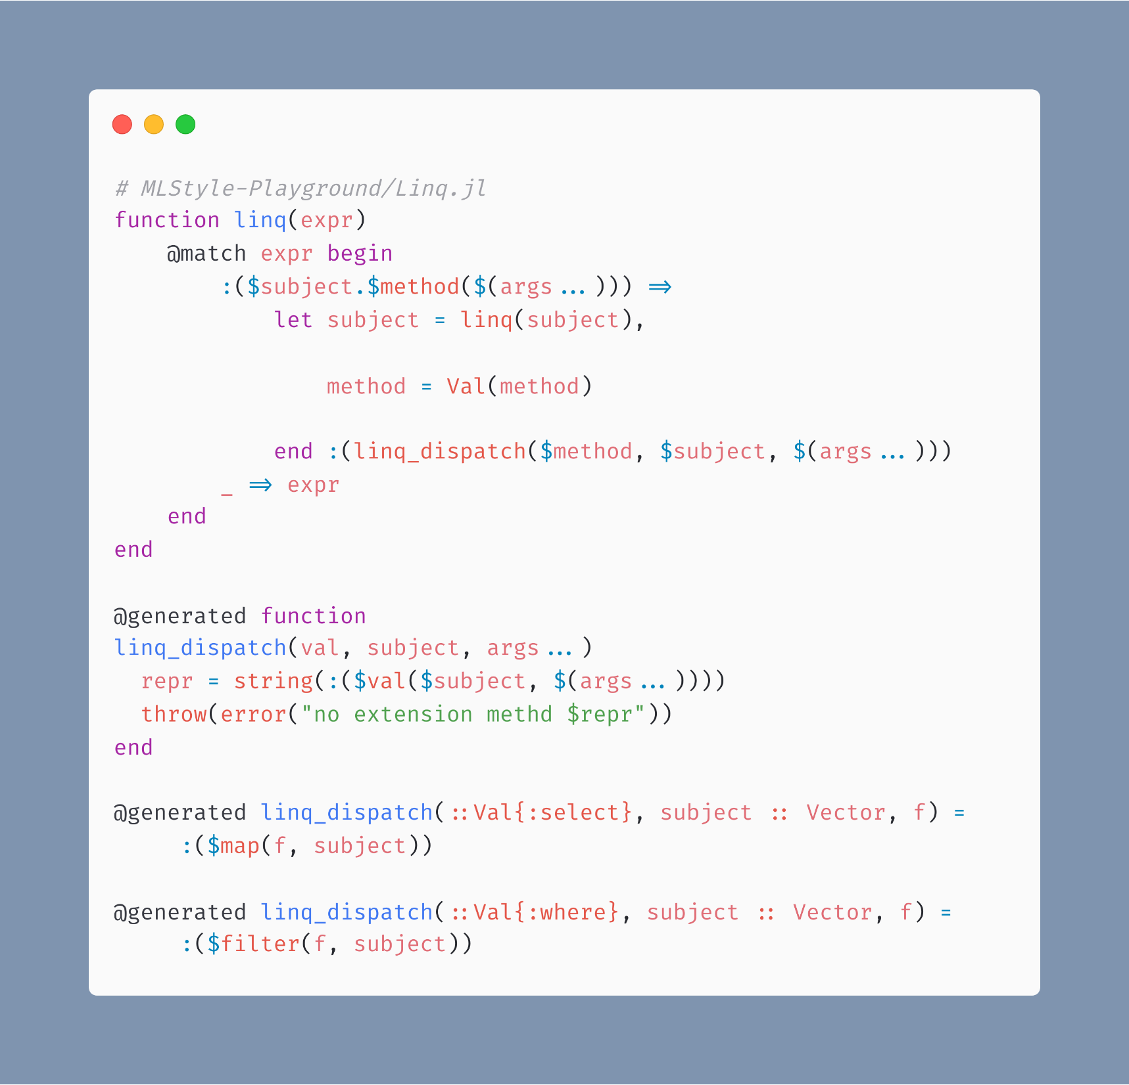
Examples – Query eDSL : Linq

Slide 41
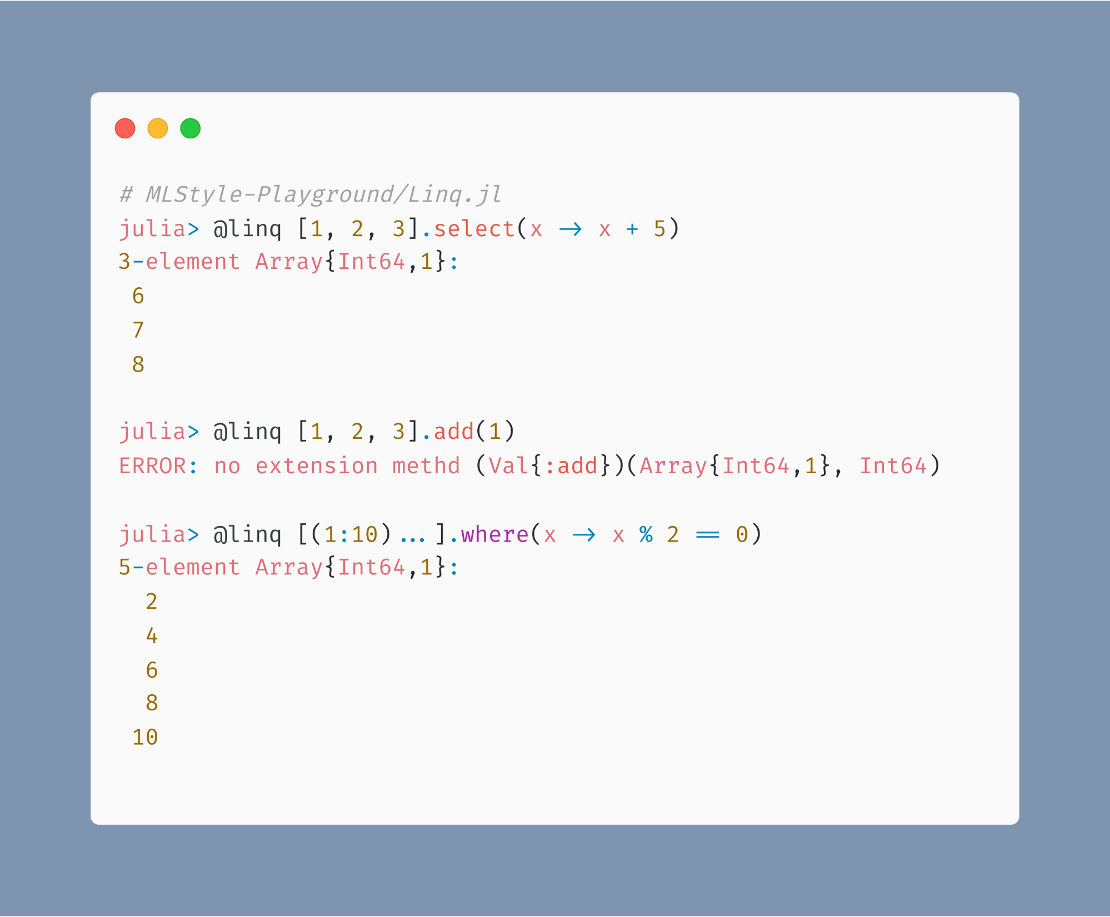
Examples – Query eDSL : Linq

Slide 42
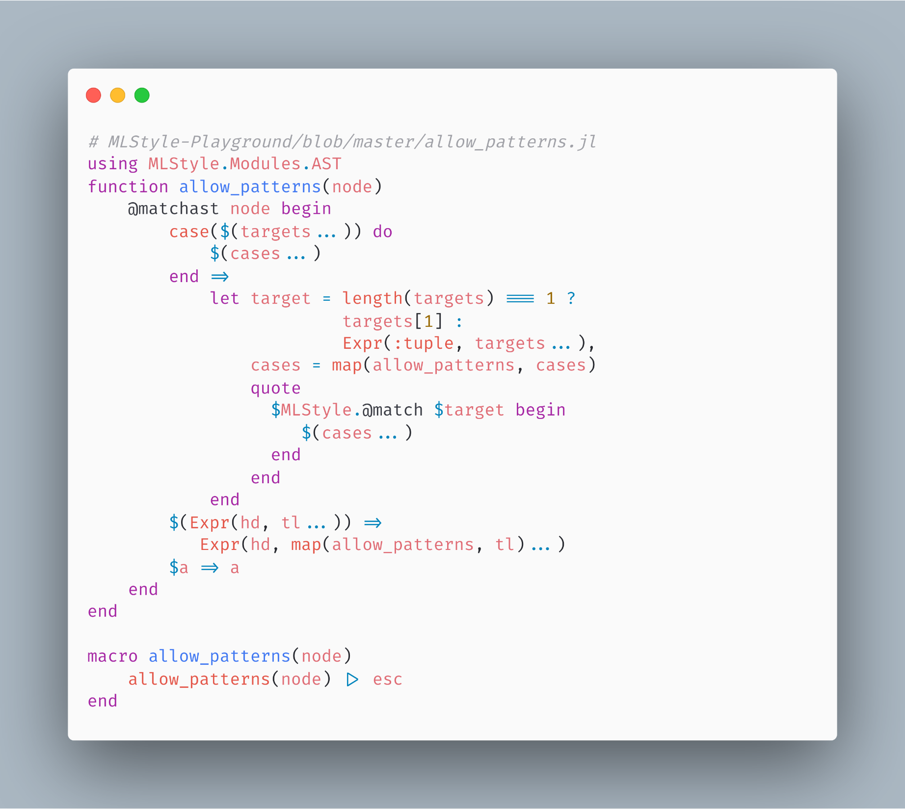
Examples – Syntax Extensions

Slide 43
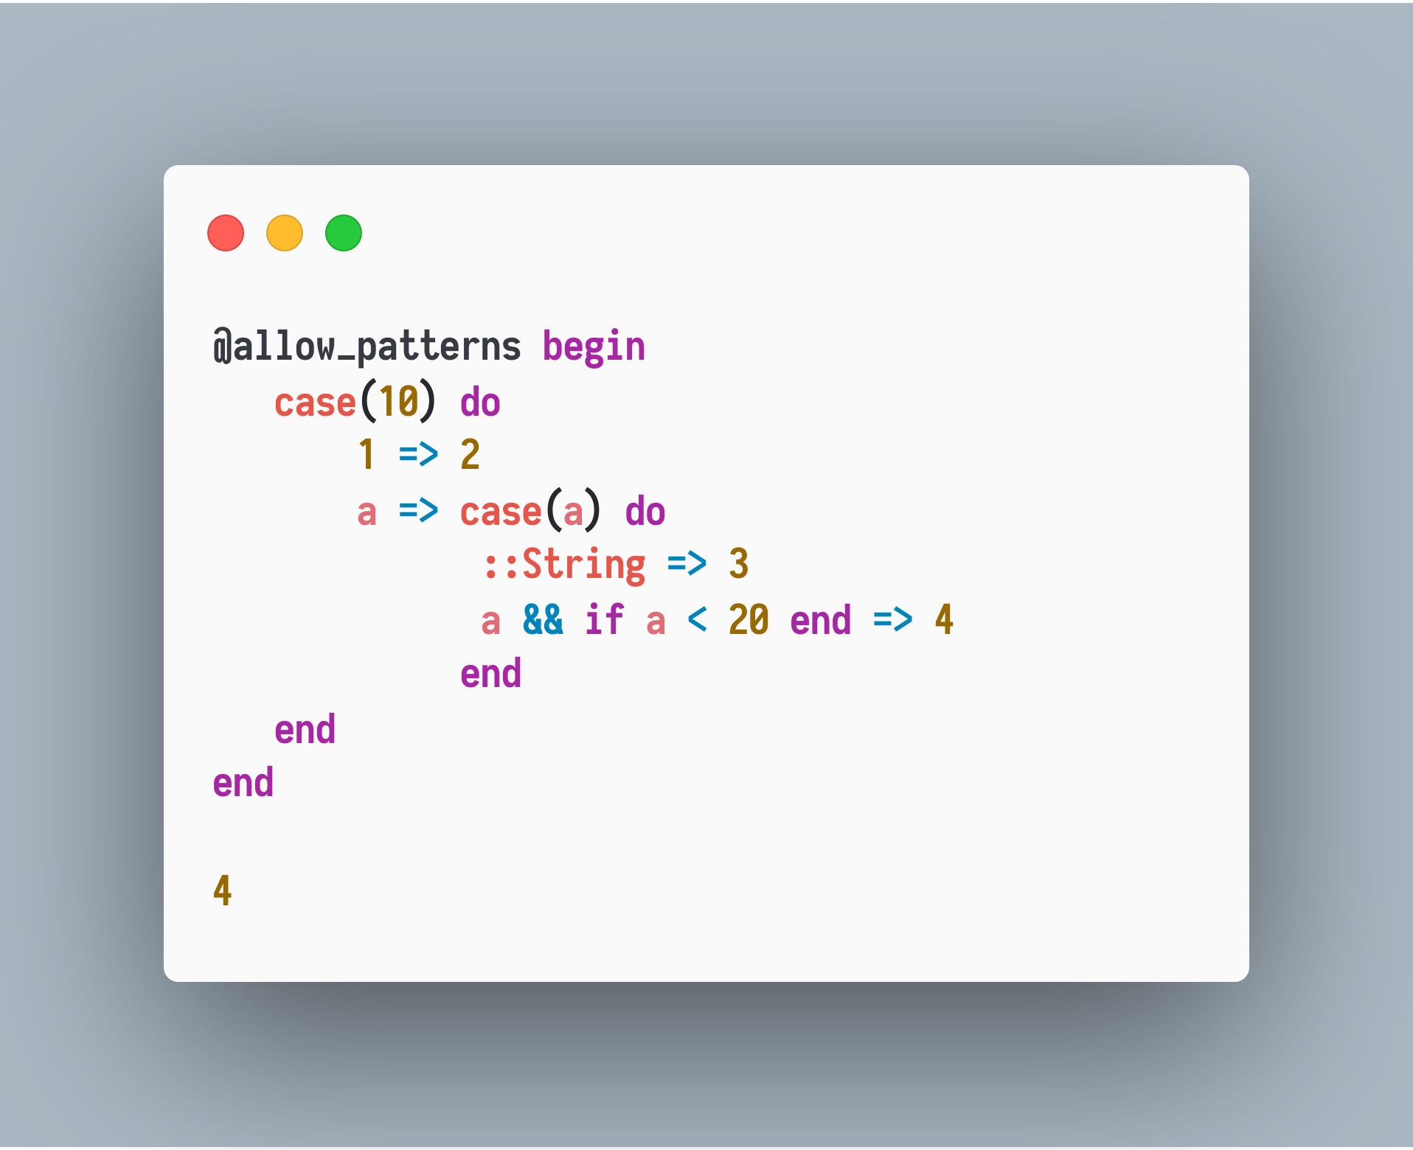
Examples – Syntax Extensions

Slide 44
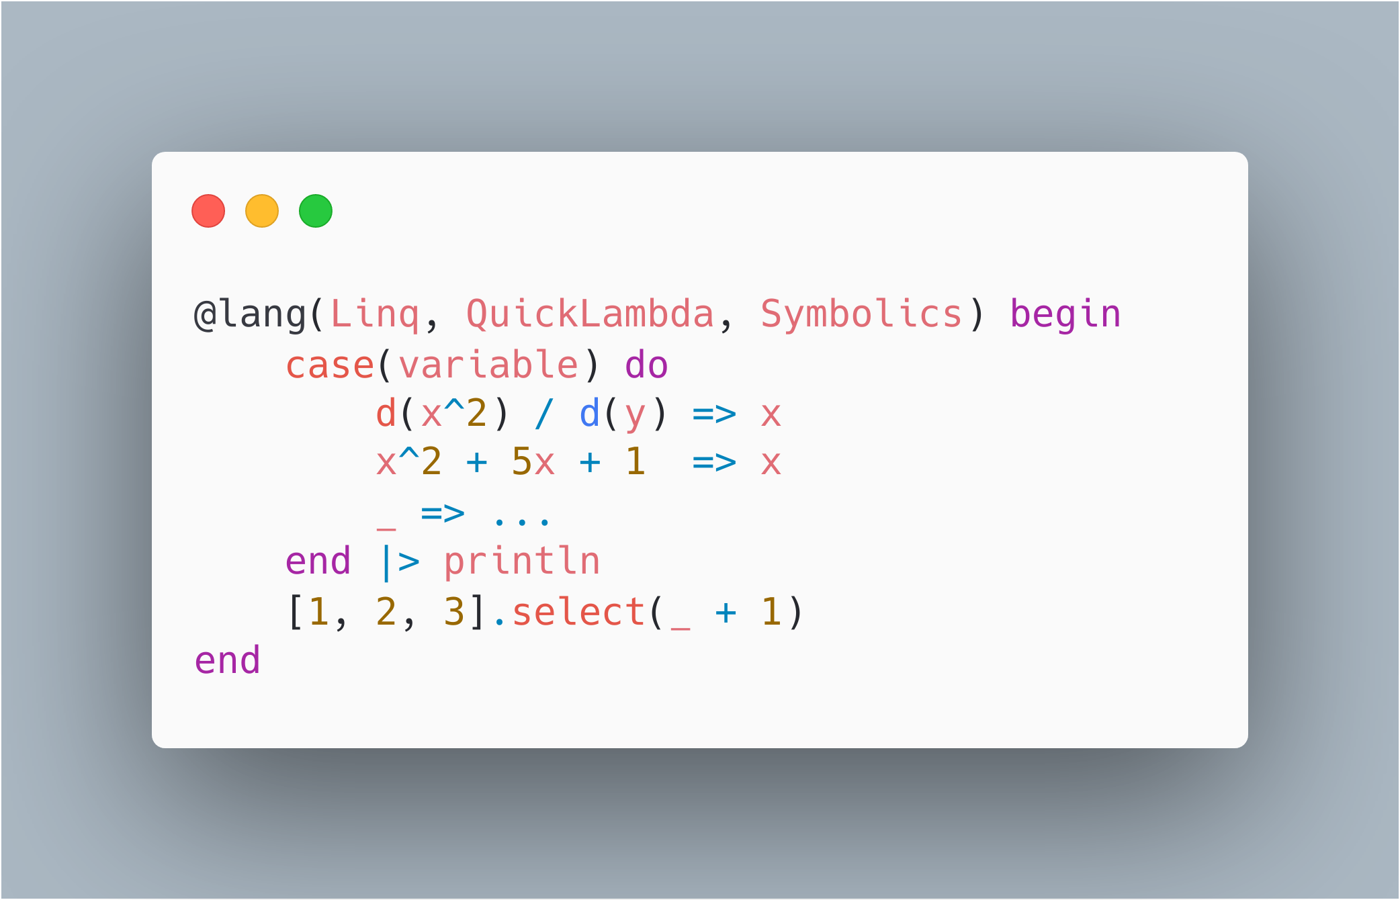
Examples – Syntax Extensions

Slide 45
Examples – Syntax Extensions

Slide 46
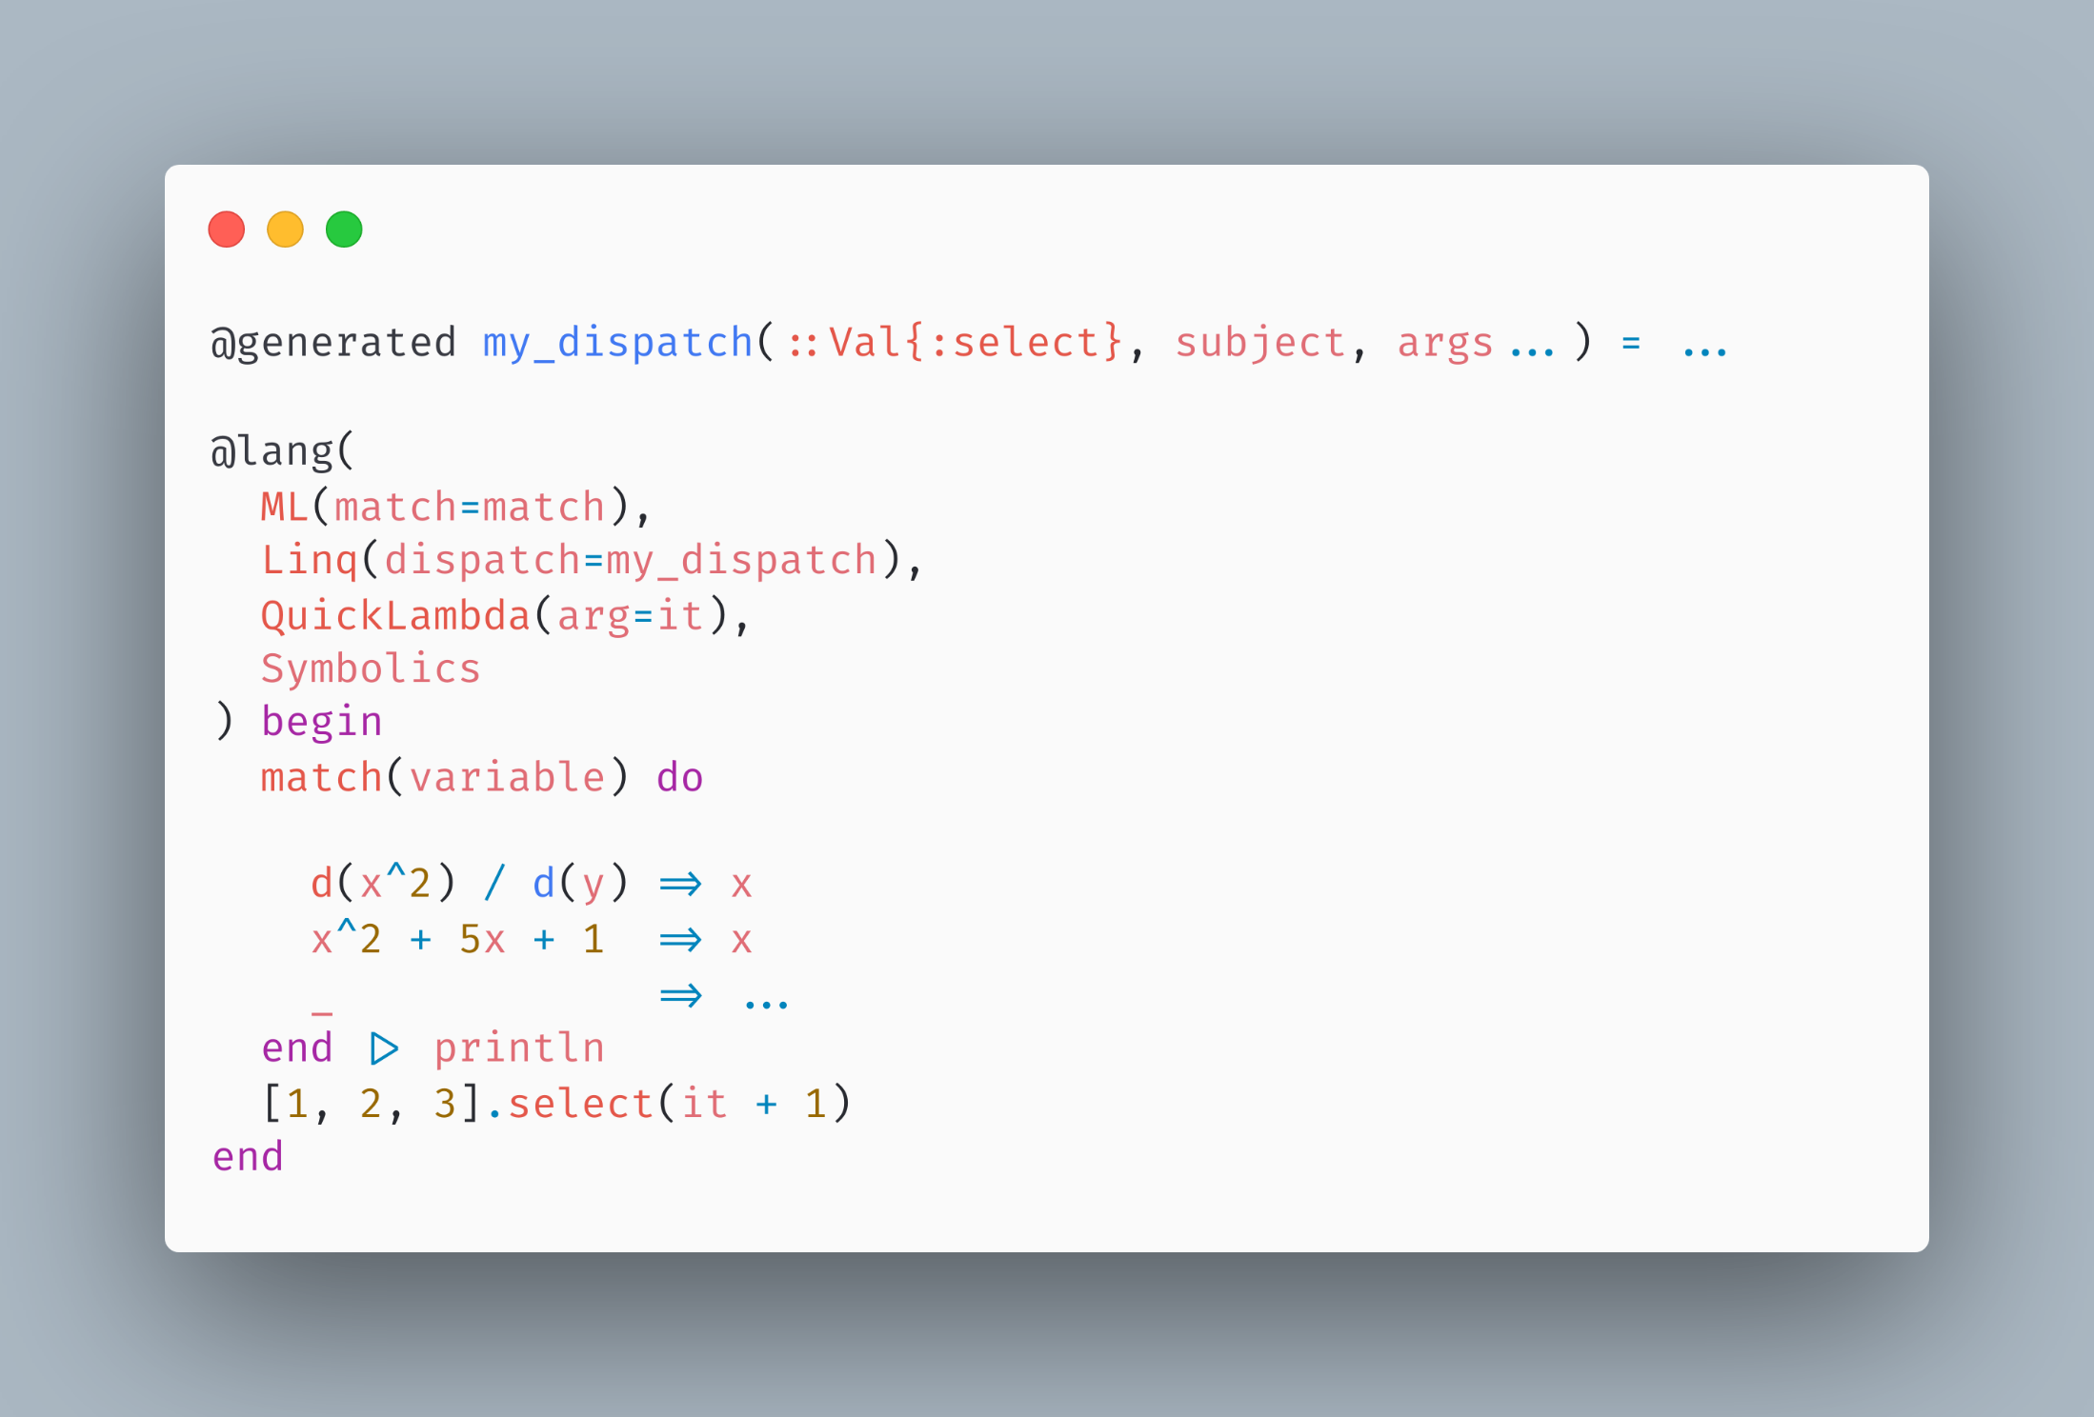
Examples – Syntax Extensions

Slide 47
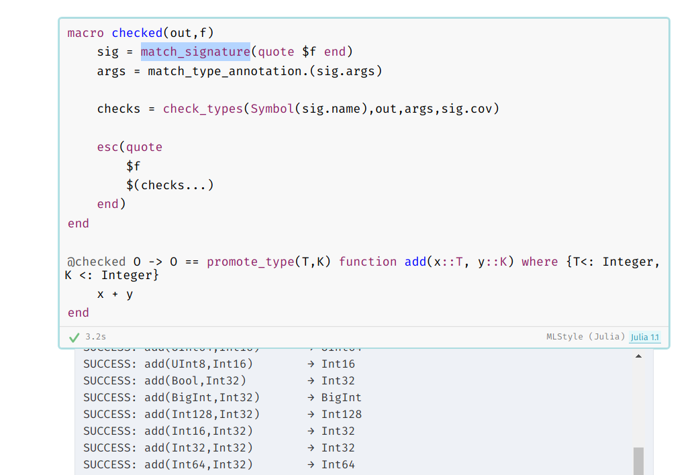
Examples – Static Type Checking
(By Jonathan Bieler)
https://nextjournal.com/jbieler/adding-static-type-checking-to-julia-in-100-lines-of-code/

Slide 48
Acknowledgements
Chad Scherrer, Arets Paeglis and Jeffrey Sarnoff, who encouraged me in the development of MLStyle.jl.
Roger Luo and JuliaCN, who gave me the chance to give a talk here.
The creators and maintainers of Julia language, thanks for bringing us such a surprising language as well as such an active community.
My parents, who support me in every aspect of my life.
The main contributors listed in https://github.com/thautwarm/MLStyle.jl/blob/master/acknowledgements.txt

